Slide 1
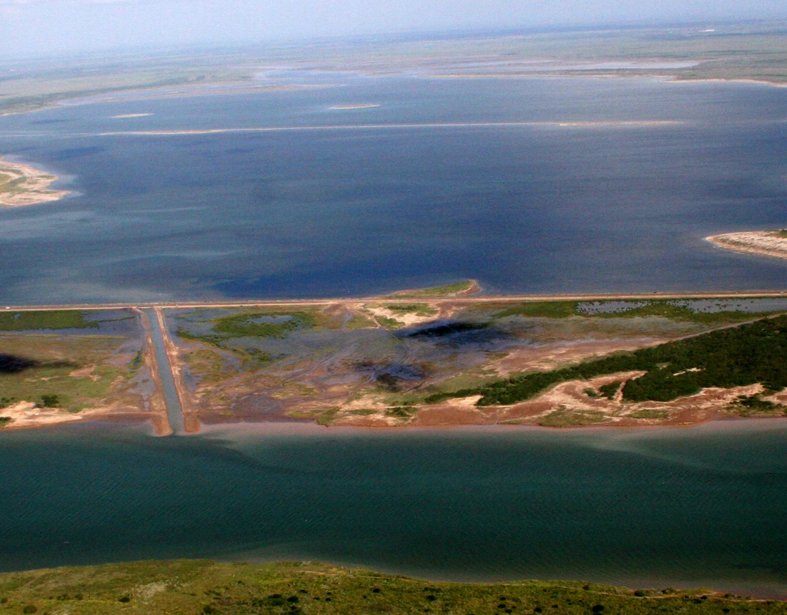
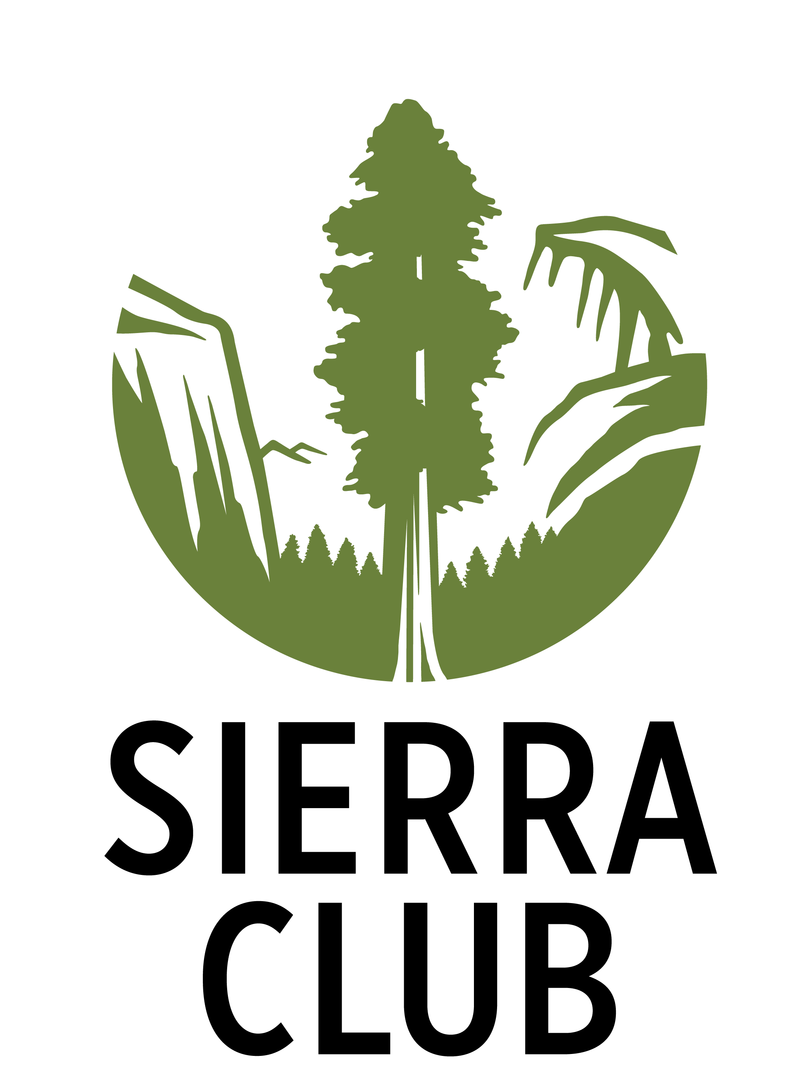
Bahia Grande: Heart of the Corridor
Lower Rio Grande Valley Sierra Club
Notes:
My name is ____ and I am a member of the Lower Rio Grande Valley Sierra Club group. Today, I am presenting about the Bahia Grande, the largest wetland restoration project in North America.

Slide 2
Bahia Grande and Surrounding Area, Pre 1936
The southern tip of Texas along the Gulf looked much different 80 years ago, with many more bays and wetlands.
Notes:
This is a map of the Bahia Grande and the surrounding area pre 1936. As you can see, the southern tip of Texas, along the Gulf looked much different 80 years ago, with many more bays and wetlands. This is before the creation the Brownsville Ship channel.

Slide 3
After Construction of Brownsville Ship Channel and Hwy 48
In 1936, the Brownsville Ship Channel was completed. The piled up dredging material cut off the Bahia Grande and other wetlands from the Gulf. The construction of HWY 48 in the 1950’s further blocked any flow.
Notes:
You can see the Bahia Grande, HWY 48, and the ship channel in this photo. Here, the Bahia is now dry. The Bahia used to actually extend south of the where the Ship Channel is now.

Slide 4
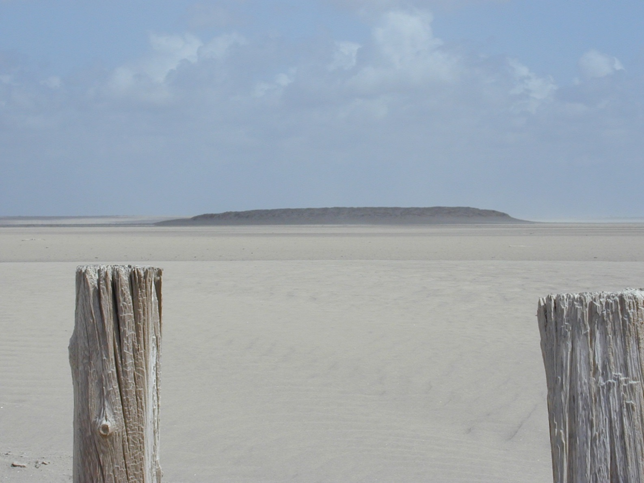
The Bahia and surrounding wetlands became a desert.
Notes:
The mound you see in the distance is “bird island.” It was once a productive bird rookery, a place where gull-billed terns and black skimmers nested and raised their young.

Slide 5
The Bahia Grande then became a dustbowl
Without tidal flow, the Bahia Grande and shallow bays to the south dried up, and became the sources of blowing salty clay dust.
Notes:
This is a photo of the dust in the Bahia Grande.

Slide 6
The Dust Bowl Era
For 70 years, blowing dust plagued Laguna Vista and Port Isabel.
The dust affected schools, people’s health, highways, and even electrical boxes.
Notes:
This photo is from the local newspaper.

Slide 7
In 1999, the Dept. of Interior purchased the Bahia Grande and surrounding area, 21,000 acres and all.
Notes:
They have plans to restore the Bahia Grande.

Slide 8
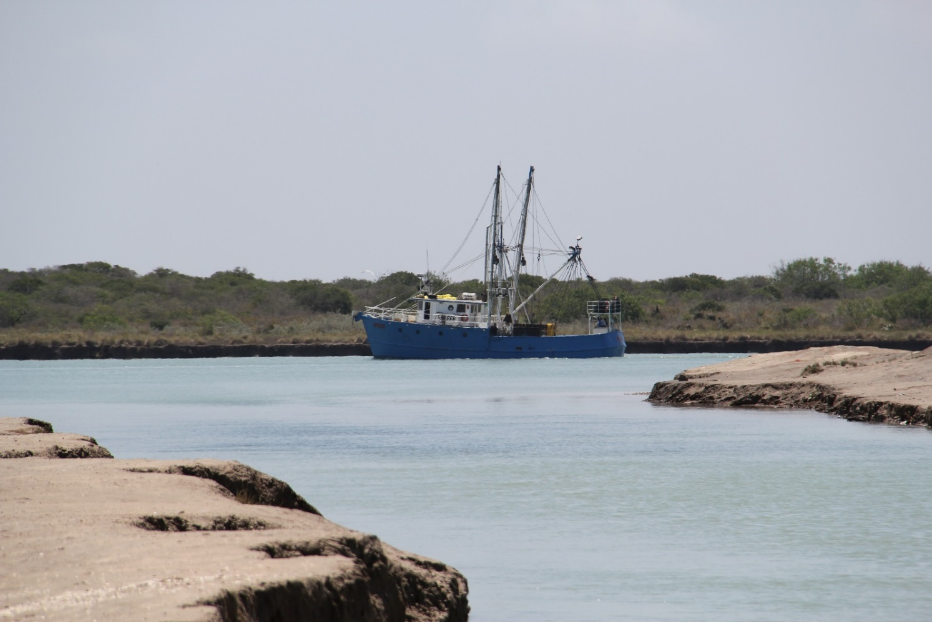
Bahia Grande Restoration, 2000- 2005
65 local, state, and federal agencies, corporations, foundations, schools, conservation groups, and commercial and recreational fishing organizations worked together to restore the once productive bay.

Slide 9
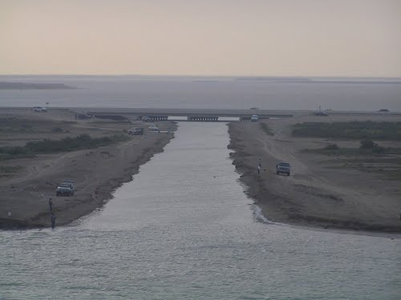
The “cut” becomes a reality.
In 2005, a 60 foot wide channel was cut from the ship channel to the Bahia Grande and reflooding began

Slide 10
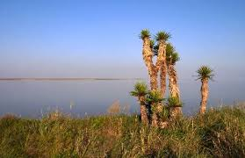
At the time, the Bahia Grande was the largest wetland restoration in North America.
Before 2005 Restoration
After 2005 Restoration

Slide 11
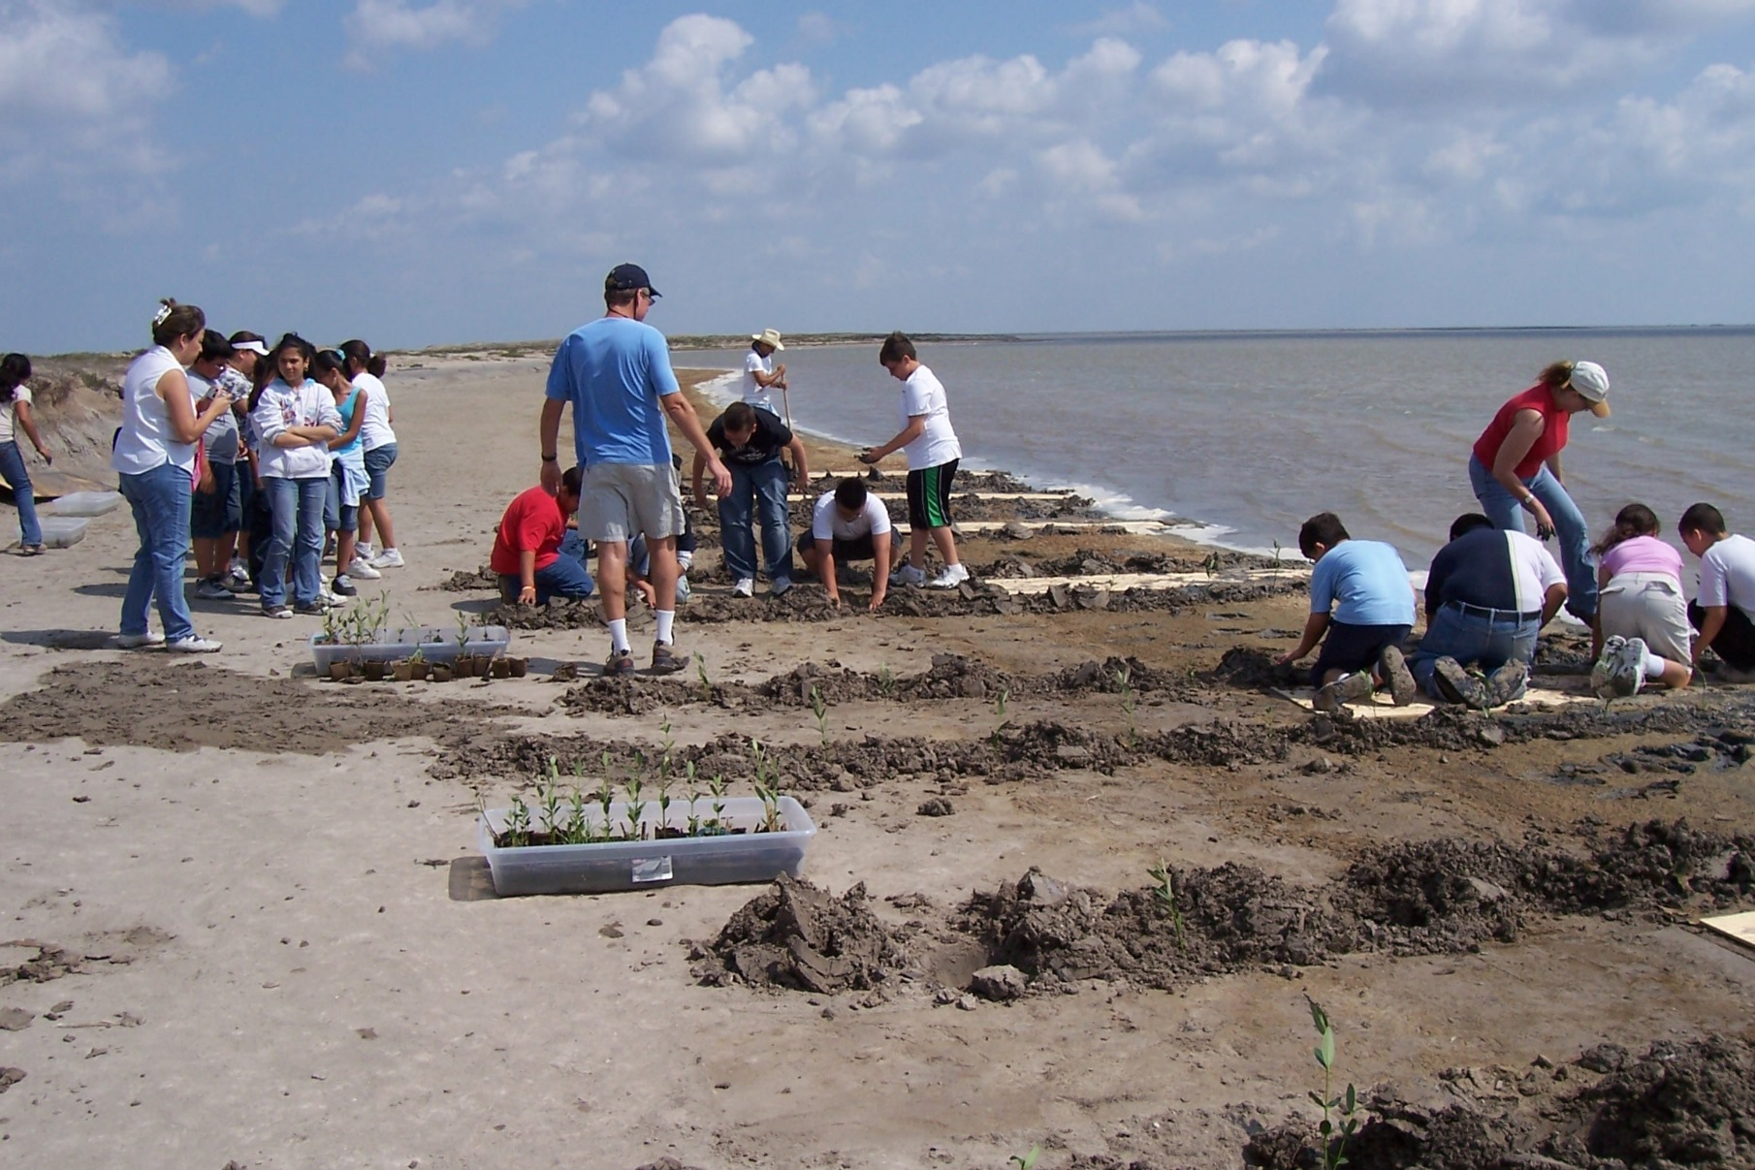
The Bahia Grande, Volunteer Revegetation
Local high school and college students were part of the restoration effort.
Hundreds of volunteers raised and planted wetland vegetation around the edge of the Bahia.

Slide 12
Student planting black mangrove seedling
Black mangrove is perhaps the most important wetland plant, as it provides nursery habitat for fish and shellfish.

Slide 13
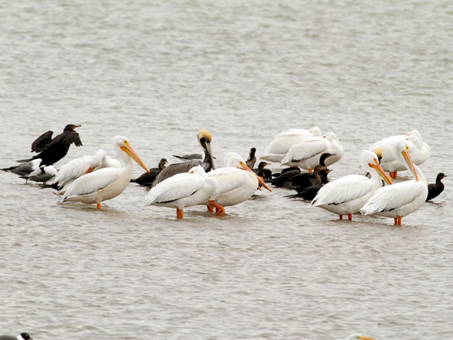
Restore a wetland and they will come.
Very quickly, birds and fish returned to the long-dead Bahia Grande. Gull-billed terns, black skimmers, and brown pelicans returned to nest.
But all was not perfect in this wetland paradise.

Slide 14
A four year multidisciplinary study revealed that the water flow into the Bahia was insufficient, causing frequent excessive salinity due to evaporation and poor circulation.
A wider channel was needed.

Slide 15
The goal? Another South Bay, only twice as large.
South Bay almost suffered the same fate as the Bahia Grande when the ship channel was dredged.
But an opening was preserved, and today South Bay is one of the most productive bays on the Texas coast.

Slide 16
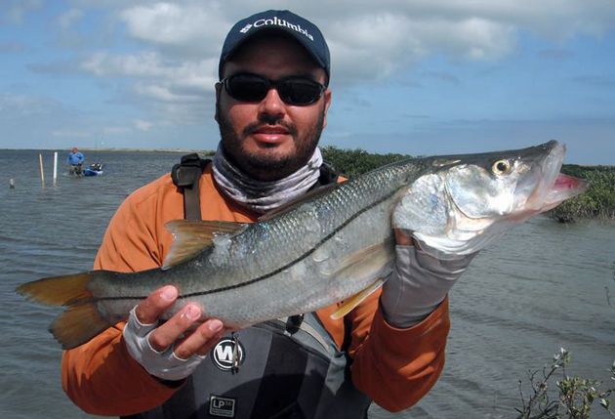
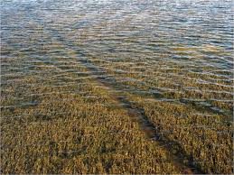
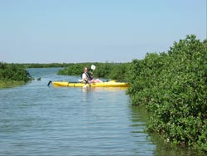
In 1994, South Bay was named the first Texas’ Coastal Preserve. Due to its seagrasses, Eastern Oyster reefs, Black Mangroves, and clear shallow water, it is immensely productive. Imagine another bay twice that size.

Slide 17
Further wetland restoration is done.
In 2007, additional cuts are made to reflood Laguna Larga and Little Laguna Madre, together over 2400 acres.
Laguna Larga
Little Laguna Madre

Slide 18
Bahia Grande, Lomas and South Bay
Bahia Grande
South Bay
Lomas

Slide 19
What’s ahead?
Plans are underway to widen the cut to 200ft, channel freshwater runoff into the Bahia from the north and restore an additional wetland: the Paso Corvinas.

Slide 20
Public Use
Discussion and planning for public use is about to happen. Ideas include: fishing, hunting, kayaking, hike and bike trails, and even a visitor and education center near HWY 100.
Notes:
This is the cut going into the Bahia, off of HWY 48.

Slide 21
Restoration is on-going.
It won’t be easy. Threats are many.
Including: increasing urban development, fragmentation and isolation of natural areas, decreased water quality, increased sediment loads and pollutants within marshes, bays, and estuaries. Multiple LNG export terminals could cause massive impacts.

