Slide 1
Pipelines & Rio Grande Valley
Basic Info – what, why, and where?
The proposed pipelines
Hazards and Safety
Recent Incidents

Slide 2
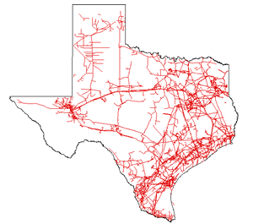
Pipelines 101
Interstate: A pipeline that crosses
one or more state borders.
Texas has 13,600 miles of
interstate natural gas pipelines
Intrastate Pipelines: Operate
within state borders
and link to interstate
Networks. Texas has the
Most intrastate natural gas
pipelines in the country
with 45,000 miles!
Notes:
Miles of pipelines are based on numbers from 2007/2008 data as currently posted on the U.S. Energy Information Administration website as of 5/10/2017.
Picture from U.S. Energy Information Agency natural gas website:
https://www.eia.gov/pub/oil_gas/natural_gas/analysis_publications/ngpipeline/intrastate.html

Slide 3
What will be in the pipelines?
“Natural” Gas.
Natural is a marketing term used in many industries such as food, pet, clothing, and the oil and gas industries
Natural gas is in reference to the product purified methane
Is “natural” gas natural? NOT REALLY
Natural gas is extracted via fracking using over 500 chemicals, sand and water.
Methane naturally has many other hydrocarbons including ethane, propane, butane, and pentanes. Also contains water vapor, hydrogen sulfide, carbon dioxide, helium, nitrogen, and other compounds.
“Natural” Gas refers to “pure” methane which is highly processed to get rid of contaminants.
Once the methane is “pure”, it is ready to be sent through pipelines.
Notes:
Hazards of methane: http://www.pbs.org/newshour/updates/california-natural-gas-leak-just-one-of-thousands-across-country/
See http://naturalgas.org/naturalgas/processing-ng/ for info on processing of natural gas (4 stages/steps)
Pipeline quality gas is defined as natural gas (1) within +/- 5% of the heating value of pure methane or 1,010 Btu per cubic foot under standard atmospheric conditions, and (2) free of water an toxic or corrosive contaminants. (https://www.croftsystems.net/oil-gas-blog/what-are-pipeline-specifications-and-why-are-they-important)

Slide 4
Why are pipelines proposed in our area?
1) To export “Natural” Gas to Mexico via pipelines
2) To supply “Natural” Gas to LNG companies that will export the gas in liquid form (LNG) overseas
Is there a conflict between the goals of energy independence and exportation?
Notes:
Is this in the public’s interest? It’s a stock claim by the companies and part of the wording of the Natural Gas Act?
In company filings, companies get to define public interest, & public often does not have the opportunity to define their interest.
Does it help the US become energy independent?
As noted on texaspipelines.com, the goal of pipeline infrastructure is to lessen dependence on foreign sources of energy (http://www.texaspipelines.com/pipelines/pipelines-101/). So why export?

Slide 5
The Pipelines
Thus far there are 2 companies and 3 pipelines
Valley Crossing (formerly know as Nueces-Brownsville):
- single pipeline
2) Rio Bravo Pipeline:
- 2 pipelines that run parallel to each other.
More may be on the way:
Kingsville to Brownsville (Annova LNG)
One for Texas LNG???
Others? Who knows what the future holds!

Slide 6
Valley Crossing
Notes:
RRC GIS Map website:
http://www.rrc.state.tx.us/about-us/resource-center/research/gis-viewers/

Slide 7
Valley Crossing
Texas Railroad Commission (RRC) Public GIS Map
Notes:
The red circle indicates a different route than provided to FERC

Slide 8
Valley Crossing Pipeline
Single 42” and 48” diameter pipeline. (FERC Project Description p9)
165 miles long from Nueces County to off shore into Gulf of Mexico.
Under jurisdiction of the Texas Railroad Commission.
Owned by Enbridge.
Mission: to export methane to Mexico’s state owned utility Comision Federal de Electricidad (CFE).
Construction start April, 2017 and in service October, 2018.
Will NOT include service to LNG facilities
Things that make you go mmm…...
While they indicate who they are selling to internationally, they are not so quick to indicate who they will be providing gas to in Texas. Are the 6 pipeline systems they will connect to considered customers?
Will exporting gas to Mexico lessen their need to import LNG, thus competing with LNG in the Valley?
Notes:
Diameter seems to be 48” and changes to 42” once it hits Cameron County.
What is right of way width? Construction will be 100’-125’. Permanent ROW is 50’
Pipeline buried with 3’ minimum.
Valley Crossing Construction Dates: were expected to start April 1st, 2017 according to FERC filing on 2/17/2017 and finish Summer 2018.
Border Crossing construction to being August 1st, 2017 according to Original FERC Project Description filed 11/21/2016
FERC filing 2.17. 2017: Valley Crossing currently plans to interconnect with six gathering and intrastate pipeline systems at the Nueces Header near Agua Dulce. Descriptions of the four gathering and intrastate pipeline systems identified in the Application are as follows:
1)Houston Pipe Line, an intrastate natural gas pipeline owned by Energy Transfer Partners, LP;
2)Kinder Morgan Tejas Pipeline, an intrastate natural gas pipeline owned by Kinder Morgan, Inc.;
3)Channel Industries Gas Pipeline, an intrastate natural gas pipeline owned by Enterprise Products Partners LP; and
4) Lobo Pipeline Company, an intrastate natural gas gathering system owned by Energy Transfer Partners, LP.

Slide 9
Border Crossing
Notes:
The yellow circle indicates a different route than indicated on TRC GIS map.

Slide 10
Valley Crossing’s Border Crossing
Last 1,000 feet of pipeline before international boundary to Mexico.
Single 42” diameter pipeline.
Considered a separate pipeline project even though it is connected to the Valley Crossing Pipeline and part of the mission of Enbridge to export to Mexico.
Under the jurisdiction of the Federal Energy Regulatory Commission (FERC) and undergoes an Environmental Impact Statement.

Slide 11
Rio Bravo Pipeline

Slide 12
Rio Bravo Pipeline

Slide 13
Rio Bravo Pipeline
FERC description
2 parallel 42” diameter pipelines.
137.3 miles
Pipeline 1: 125’ construction ROW, 75’ permanent ROW
Pipeline 2 will be installed approximately 18 months after the Pipeline 1, 25’ offset from pipeline 1 and within the 75’ permanent right of way. (construction diagrams)
3 compressor stations
27 acre compression station along Hwy 48

Slide 14
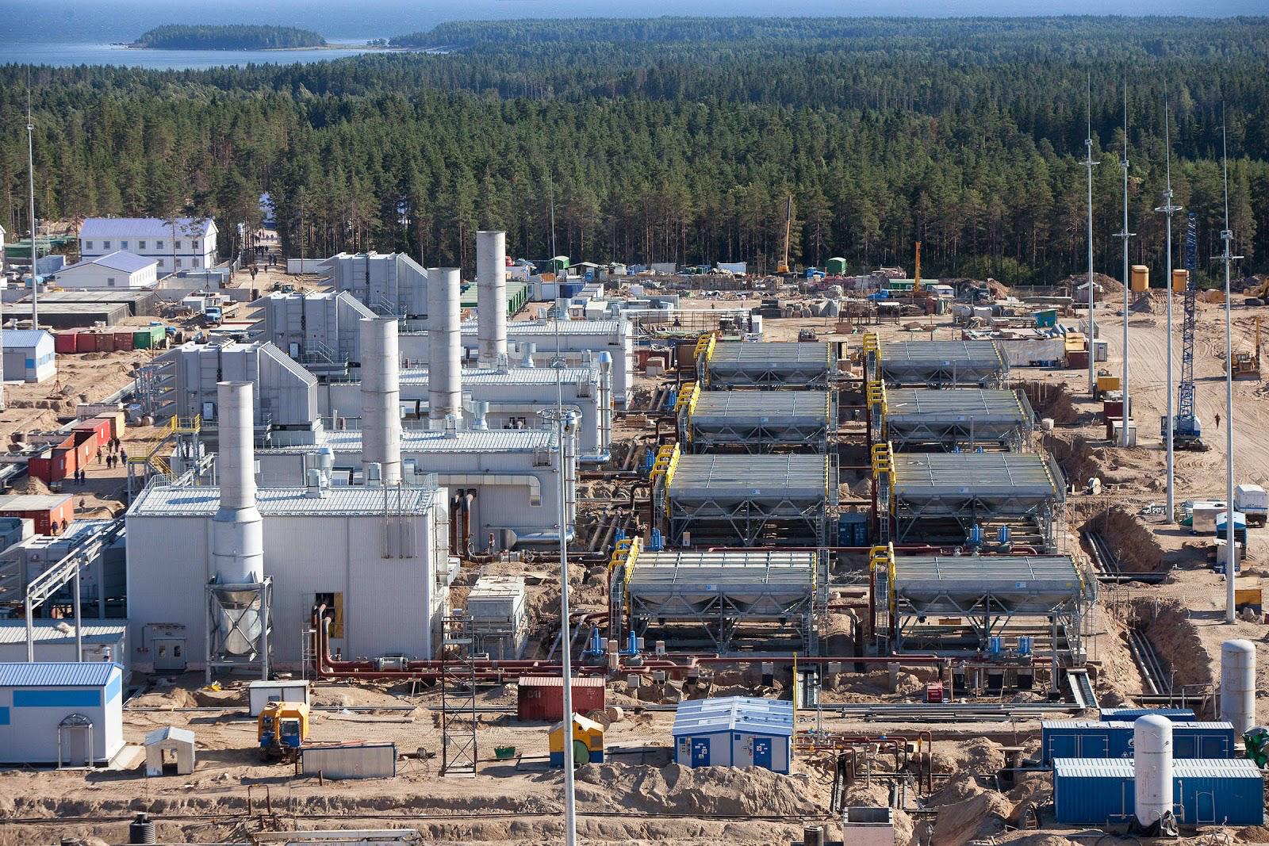
Natural Gas Compressor Stations
Notes:
http://facts-natural-gas-content.blogspot.com/2014/07/compressor-stations.html

Slide 15
Rio Bravo Compressor Station 3

Slide 16
Valley Crossing Compressor Station 2

Slide 17
What does pipeline construction look like?

Slide 18
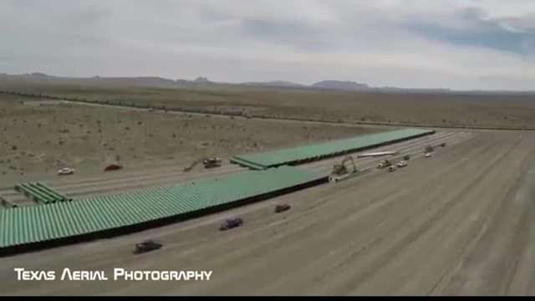
Pipeline Yard

Slide 19
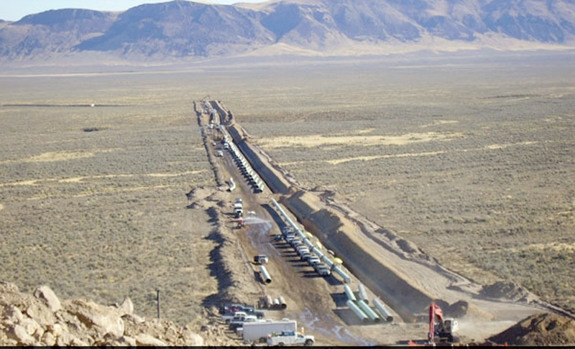
Trans-Pecos Pipeline

Slide 20
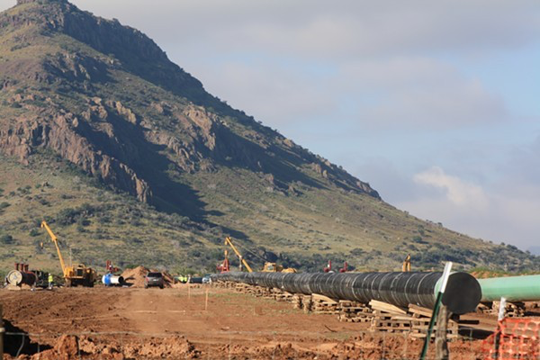
Trans-Pecos

Slide 21
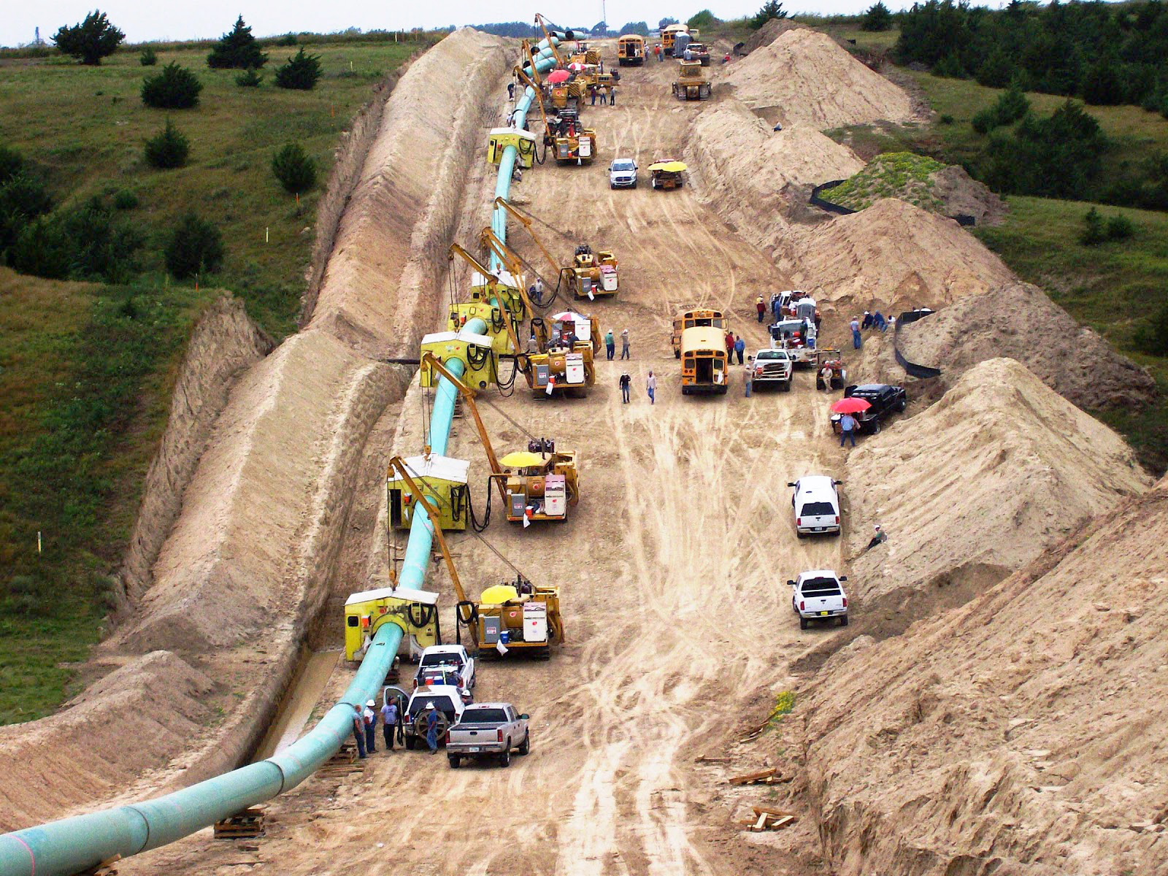
Trans-Pecos

Slide 22
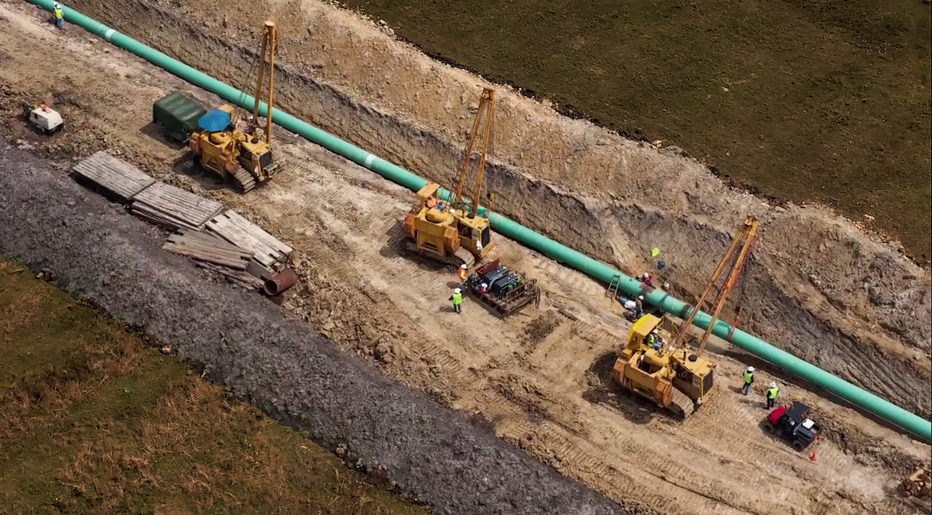
Trans Pecos

Slide 23
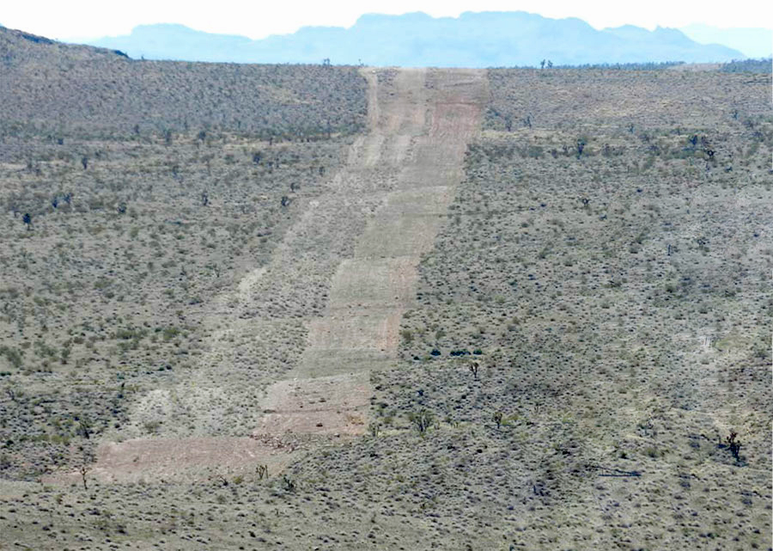
A Completed Permanent Pipeline Easement

Slide 24
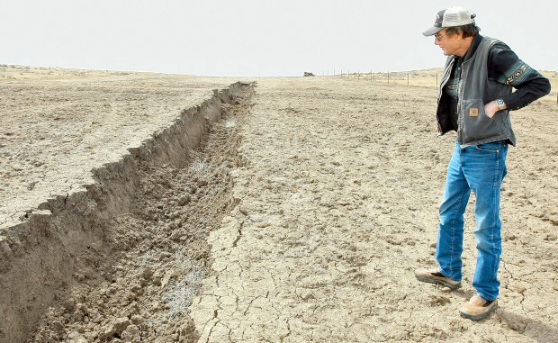
Sub-surface & Restoration Failure

Slide 25
Are Pipelines Safe? What’s the Risk? The answers depends on who you ask!
Notes:
saftey,
Risk
Accidents in texas
Recent accident nation wide
What does a natural gas pipeline look like
Who pays for response?
What are the hazard zones?

Slide 26
Notes:
http://www.ncsl.org/research/energy/state-gas-pipelines-pipeline-accidents.aspx
http://fracdallas.org/docs/pipelines.html
https://hip.phmsa.dot.gov/analyticsSOAP/saw.dll?Portalpages

Slide 27
Notes:
Texas Pipeline Incidents

Slide 28
Reasons For Pipeline Failures
External Mechanical Force (utility work, construction digging, maintenance of pipeline, etc.).
A dent changes geometry and creates an area of high stress and stress concentration.
Gouge reduces resistance to crack initiation
Pipeline Failure due to external damage or fatigue
Fatigue Cracking / Transit fatigue (especially by rail or sea): Flexing of the pipe during load movement.
Earth movement, floods, fire, etc.
Corrosion: Thinning of the pipeline wall (most common)
External:
Internal:
External Stress Corrosion: accumulation of moisture on surface imperfections in the pipe coating. Cracks result from corrosives in the moisture in conjunction with normal operating stresses.
Material Defects (not as common):
Faulty weld seams or laminations.
Notes:
http://home.eng.iastate.edu/~jdm/katrina/Data/Natural%20Gas/NG%20Transportation/Analysis%20of%20Gas%20Pipeline%20Failure.pdf
https://aucsc.com/_aucsc%20speaker%20files/Coatings%20Period%2011%20AUCSC%202012%20Jeff%20Didas.pdf
https://sites.google.com/site/metropolitanforensics/root-causes-and-contributing-factors-of-gas-and-liquid-pipeline-failures

Slide 29
Recent Gas Pipeline Explosions (not all failures result in explosion)
Johnsons Co., Texas: June 2010
Cuero, Texas: June 2015
Encinal, Texas: October 16, 2015
Robertson County, Texas: January 9, 2016
Salem, Pennsylvania: April 2016
Spearman, Texas: January 18, 2017
Refugio, Texas: Februay 15, 2017

Slide 30
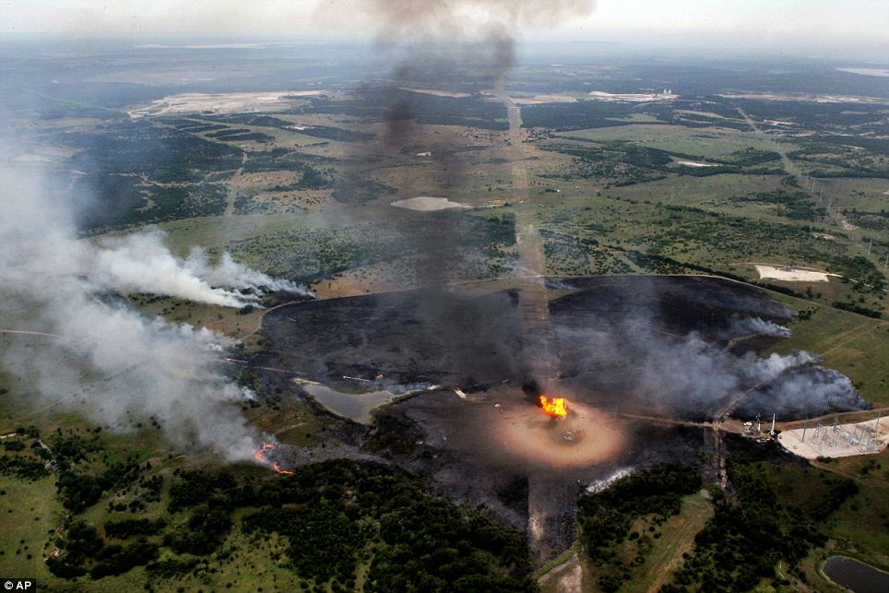
Johnson Co. Texas, June 2010
Notes:
http://www.dailymail.co.uk/news/article-1284880/Texas-gas-pipeline-explosion-kills-worker-injures-seven.html
36” pipeline, Enterprise Products Partners LP
Ruptured by utility workers = doesn’t have to be a failure of a pipeline

Slide 31
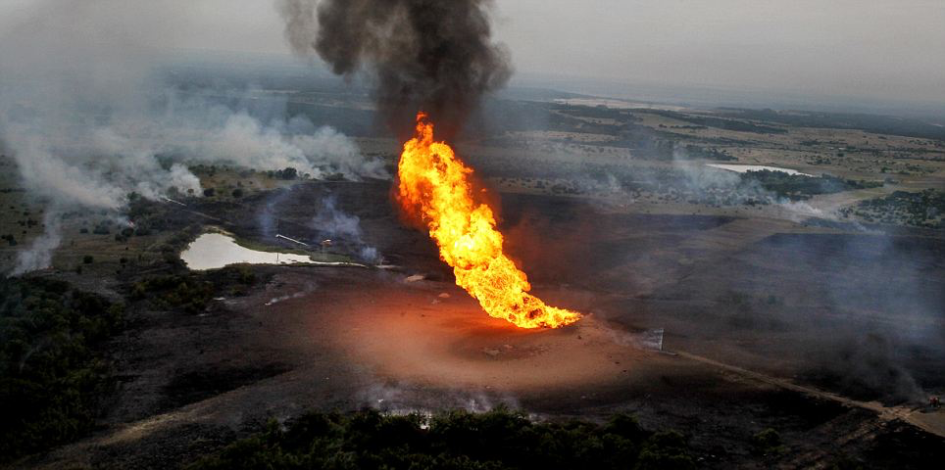
Johnson Co. Texas, June 2010

Slide 32
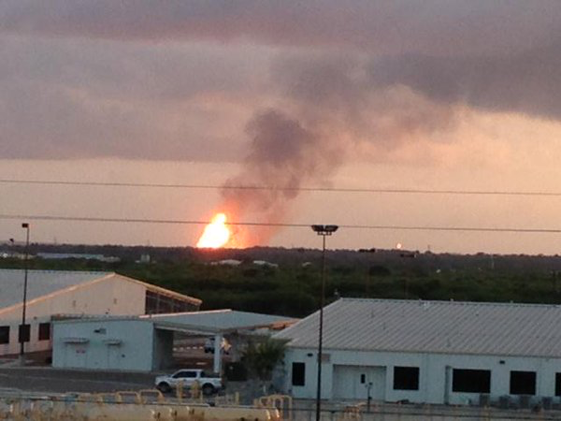
Cuero, Texas June 15, 2015
Notes:
Pipeline owned by Energy Transfer Partners
http://www.foxnews.com/us/2015/06/15/texas-pipeline-rupture-causes-fire-and-evacuations-but-no-injuries.html
Picture from a twitter post. Used by media.

Slide 33
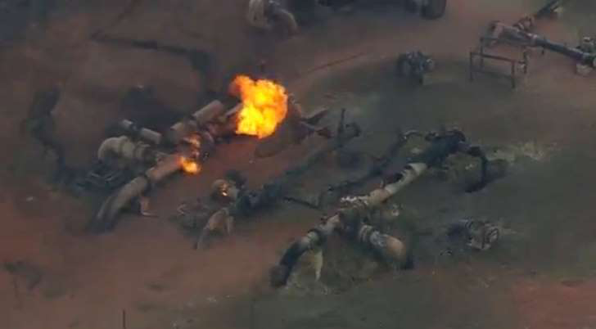
Encinal, Texas Oct. 2015
Notes:
http://www.cbsnews.com/news/texas-pipeline-facility-fire-massive-flames/
Picture: http://www.msn.com/en-us/news/us/natural-gas-pipeline-explodes-in-south-texas-no-injuries/ar-AAfvOPr

Slide 34
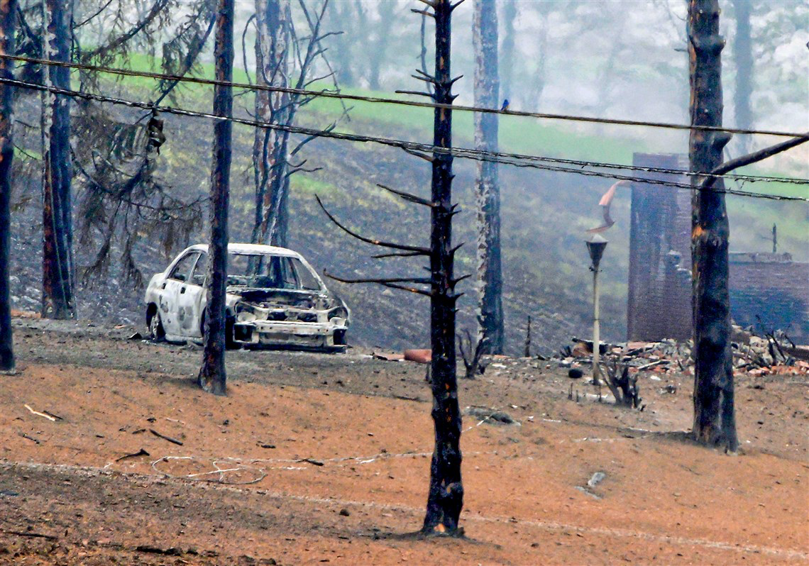
Salem, PA April 29, 2016
Notes:
30” pipeline owned by Spectra (a Texas company)
http://www.post-gazette.com/local/westmoreland/2016/04/29/Emergency-crews-respond-to-gas-well-explosion-in-Westmoreland-County-pennsylvania/stories/201604290161
Video: http://www.post-gazette.com/local/westmoreland/2016/04/29/Emergency-crews-respond-to-gas-well-explosion-in-Westmoreland-County-pennsylvania/stories/201604290161

Slide 35
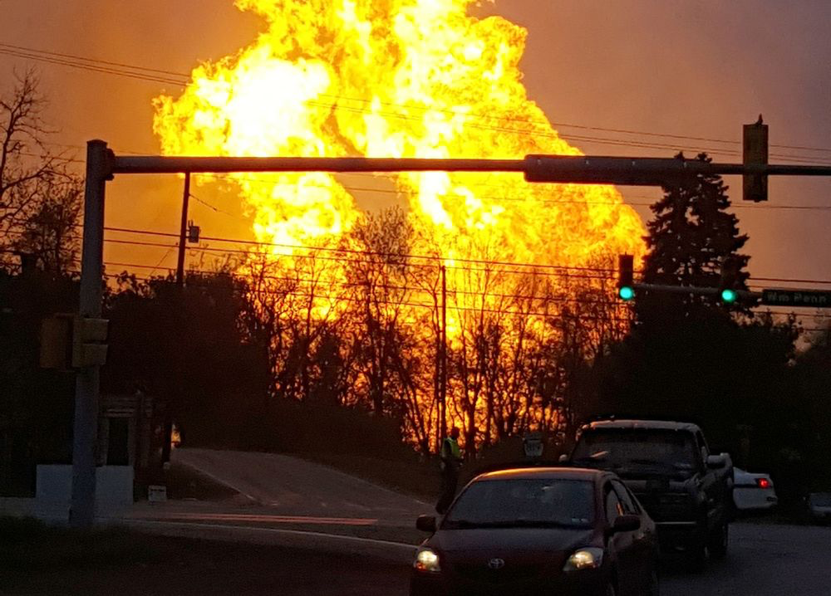
Salem, PA April 29, 2016

Slide 36
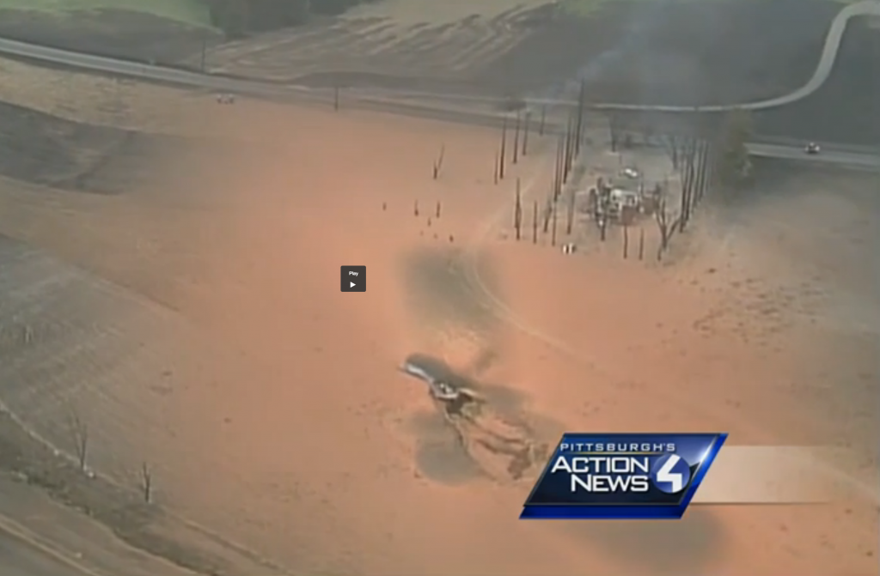
Salem, PA April 29, 2016
Notes:
http://www.nofrackingway.us/2016/04/30/massive-deadly-gas-pipeline-explosion/

Slide 37
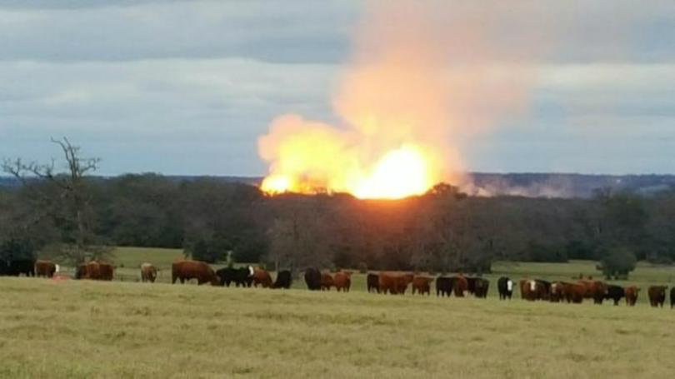
Robertson Co., Texas Jan 9, 2016
Notes:
http://www.kwtx.com/content/news/Gas-line-explosion-in--364751581.html
30” pipeline – operated by Atmos

Slide 38
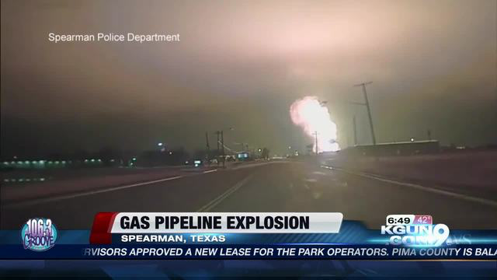
Spearman, TX Jan. 18, 2017
Notes:
http://www.kgun9.com/news/local-news/gas-pipeline-explosion-hits-texas

Slide 39
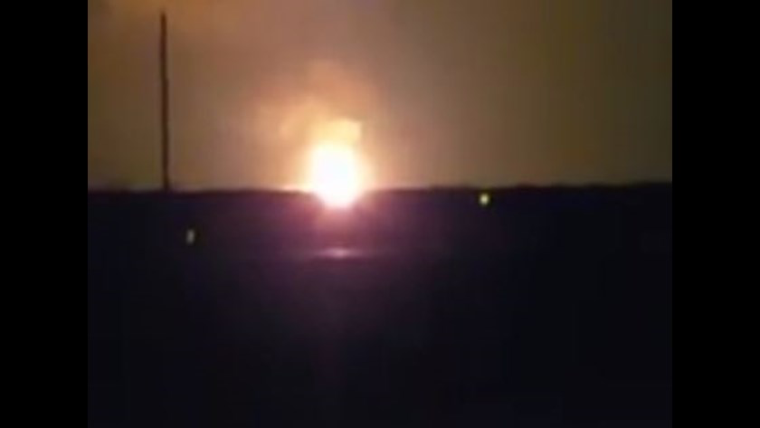
Refugio, Texas Feb 15, 2017
Notes:
Kendor Morgan pipeline
http://www.khou.com/news/local/texas/pipeline-explosion-shakes-homes-near-refugio/408507389
Picture: http://www.kvue.com/news/local/pipeline-explosion-shakes-homes-near-refugio/408524501

Slide 40
Resources
ferc.gov
http://www.pbs.org/newshour/updates/california-natural-gas-leak-just-one-of-thousands-across-country/
https://sites.google.com/site/metropolitanforensics/root-causes-and-contributing-factors-of-gas-and-liquid-pipeline-failures
https://www.google.com/search?q=pipeline+construction&source=lnms&tbm=isch&sa=X&ved=0ahUKEwj8_-fM9-bTAhVI2IMKHR38BBkQ_AUIBygC&biw=1375&bih=744#q=trans+pescos+pipeline+construction&tbm=isch&tbs=rimg:Cb_1_1hyRYMjAKIjh2fdETuxdWV6rUVBq0XEz8hBEM2o-wfxzECibxZsy2HXMMyIHNCaQ2WR5sOSbrpLxYJ6aF1zHz0CoSCXZ90RO7F1ZXEQKg_1WiGrh6nKhIJqtRUGrRcTPwR6m0mIpuISiEqEgmEEQzaj7B_1HBFoCQQ8UY_1QNSoSCcQKJvFmzLYdEVuAXMj0VXfEKhIJcwzIgc0JpDYRoyrzubSap_10qEglZHmw5JuukvBEPhT4QqeJrQCoSCVgnpoXXMfPQEQivdBCeS_1xC&imgdii=KKVy1ar3tWVE4M:&imgrc=RNlCMDa2psuXlM:
http://www.bigbendnewswire.com/environmental-assessment-deadline-site-by-feds-for-trans-pecos-pipeline/
http://www.bigbendnewswire.com/tag/trans-pecos-pipeline/
https://www.eia.gov/pub/oil_gas/natural_gas/analysis_publications/ngpipeline/intrastate.html
http://www.rrc.state.tx.us/about-us/resource-center/research/gis-viewers/
http://www.ncsl.org/research/energy/state-gas-pipelines-pipeline-accidents.aspx
http://naturalgas.org/naturalgas/processing-ng/
http://facts-natural-gas-content.blogspot.com/2014/07/compressor-stations.html
https://www.croftsystems.net/oil-gas-blog/what-are-pipeline-specifications-and-why-are-they-important

