Slide 1
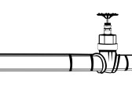
What is LNG?
Fracked gas will be delivered to the Port of Brownsville in new pipelines.
The impurities are what freeze above the liquefaction temperature of natural gas and would clog pipes and jam valves:
water,
carbon dioxide,
propane, hexane and butane, benzene (highly toxic)
toluene (highly toxic)
The LNG refinery purifies the gas.

Slide 2
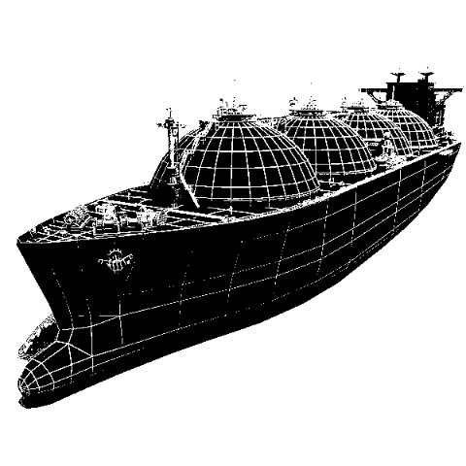
What is LNG? Continued..
Nitrogen
The LNG is exported, re-gasified, and sold in foreign markets (where there are higher prices)
Gas is cooled to -260ᵒF and 1/600th its volume.
Liquefied methane (LNG) is loaded on to tankers.

Slide 3
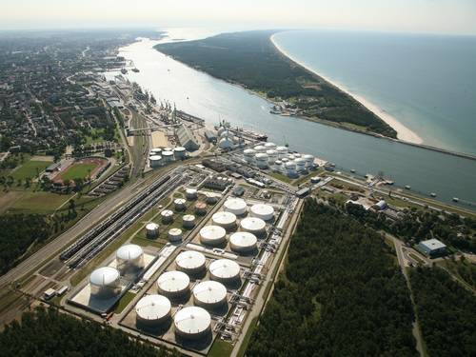
Who is LNG? Two firms have already backed out! FERC has not yet approved: Annova’s project;
Rio Grande LNG;
And Texas LNG.
A major bank, the French
Bank BNP Paribas, has
Announced it is backing out
Of all these sorts of projects,…
Annova self-finances….

Slide 4
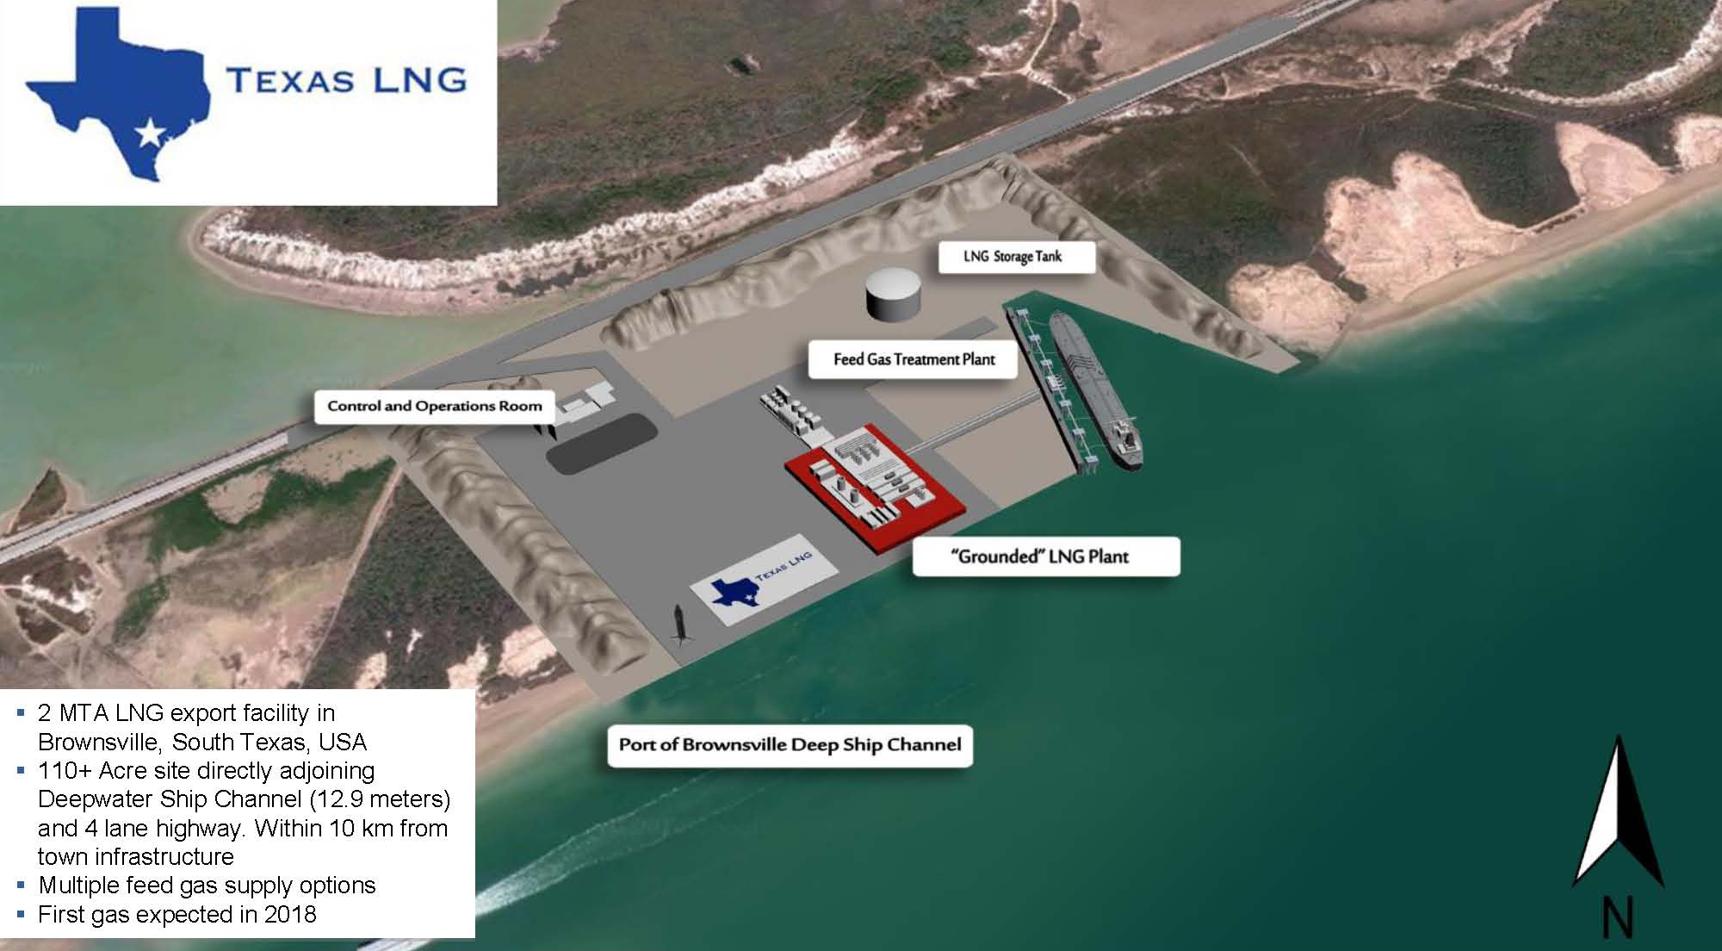
How will LNG look?
Highway 48 – To S.P.I.

Slide 5
Where will LNG be located?
Wildlife Areas
LNG Lease Options
Highways

Slide 6
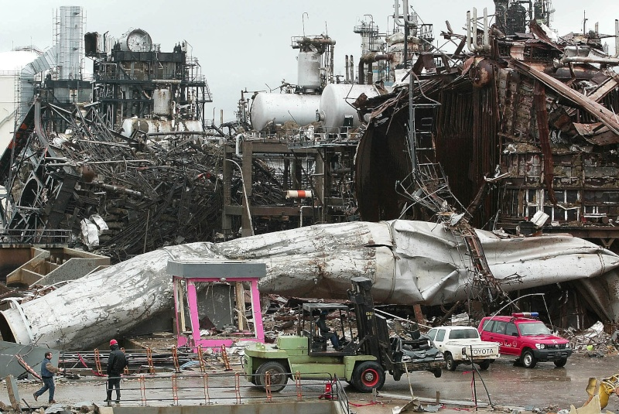
LNG: Any accident could be disastrous!
Aftermath of the Skikda, Algeria LNG explosion, January 19, 2004

Slide 7
SERIOUS DANGERS have not adequately CONSIDERED by those funding LNG and FLNG!
What prominent disasters have occurred recently? Will it really “never happen again,” given human imperfections, and the massive risks involved?
And what of the SECURITY ISSUES, even with the FLOATING LNG? Has their banker and insurance company not heard about PIRATES (Somalis?) Even a huge vessel like this can be boarded or disabled.
http://www.timrileylaw.com/LNG.htm
Not only the long term environmental harms and disasters, but also short term issues plague this whole fossil fuel technology seen as “transitional,” ... And so ... Why throw “good money after bad?”
Go STRAIGHT to RENEWABLES!

Slide 8
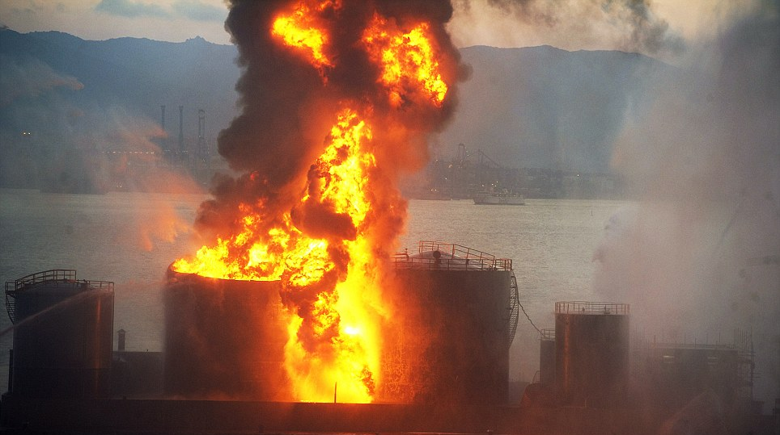
What are the dangers?

Slide 9
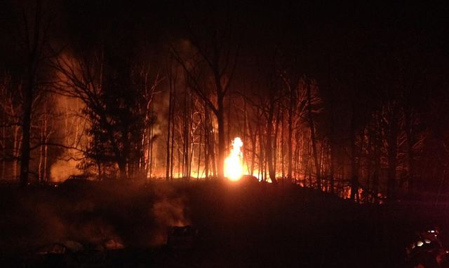
Natural Gas Disasters in the US in 2014
Natural Gas Pipeline
Knifely, Kentucky

Slide 10
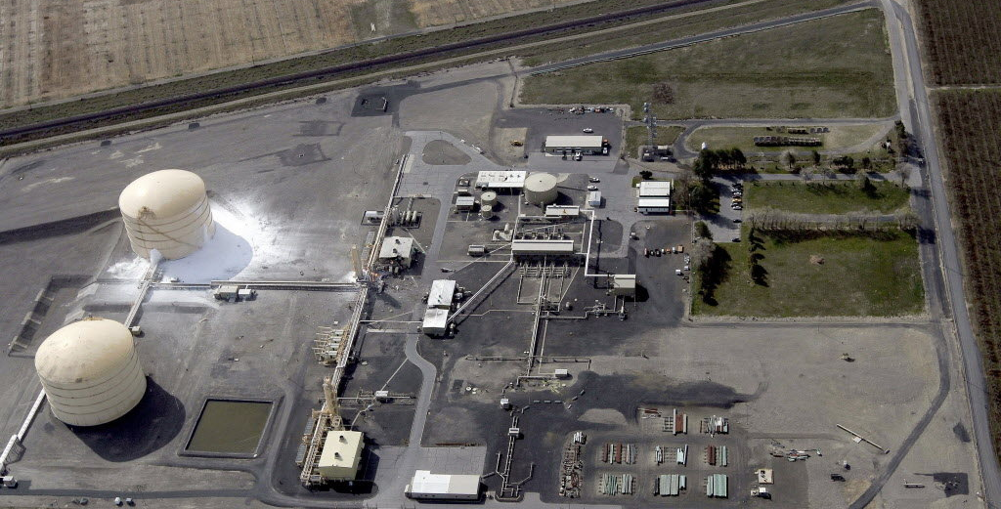
Natural Gas Disasters in the US in 2014
LNG Plant
Plymouth, Washington

Slide 11
What if a LNG ship explodes?

Slide 12
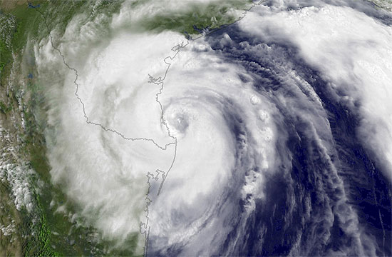
Hurricane Dolly

Slide 13
LNG facilities will be located in storm surge & hurricane prone areas
S.P.I.
Bahia Grande
Highway 48
Map showing flood risk from sealevel.climatecentral.org

Slide 14
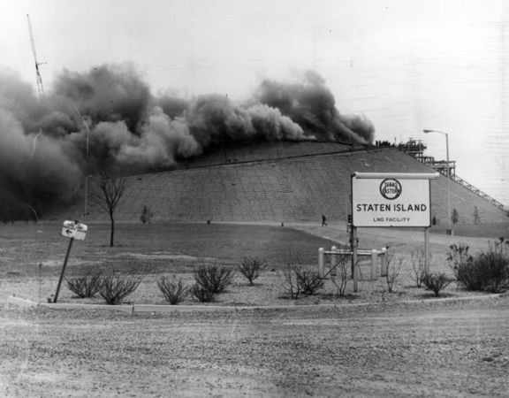
New York banned LNG after the 1973 Staten Island explosion

Slide 15
Pollution and Our Health
save RGV from LNG

Slide 16
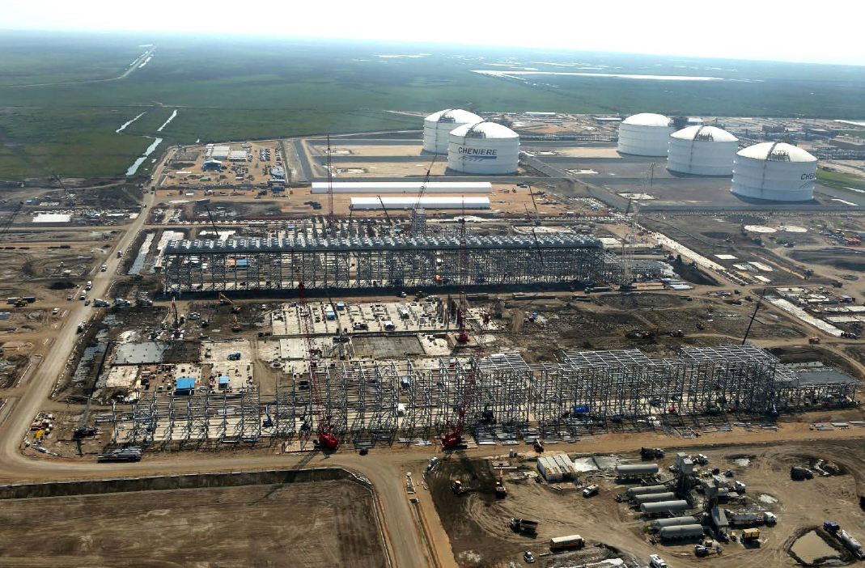
We can estimate pollution amounts based on Sabine Pass LNG
Sabine Pass, LA
LNG Plant Expected Local Emissions
90.4 tons per year (“tpy”) of volatile organic compounds
1,820.83 tpy of nitrogen oxides
2,800.6 tpy of carbon monoxide
22.5 million tpy of carbon dioxide equivalent in greenhouse gases
6.2 tpy of sulfur dioxide
117.8 tpy of particulate matter
As reported in the Sabine Pass, LLC. Environmental Assessment

Slide 17
Nitrogen Oxides (NO_{x}) 7,296 tons/year
forms smog, worsens asthma symptoms, and damages lungs
All the vehicles in Cameron County produce this much each year!!!

Slide 18
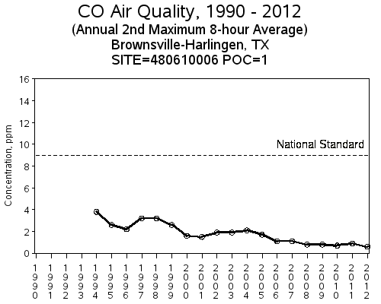
Carbon Monoxide (CO) 11,222 tons/year
CO is a poison produced when fossil fuels don’t burn completely
A 20% increase to Cameron County!!!

Slide 19
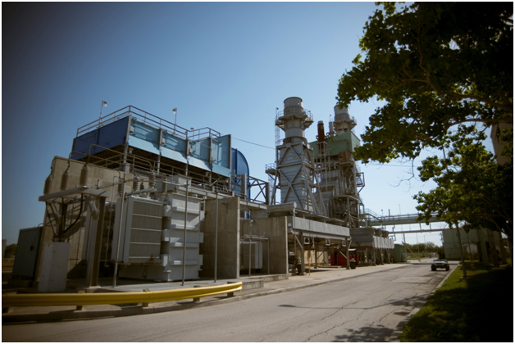
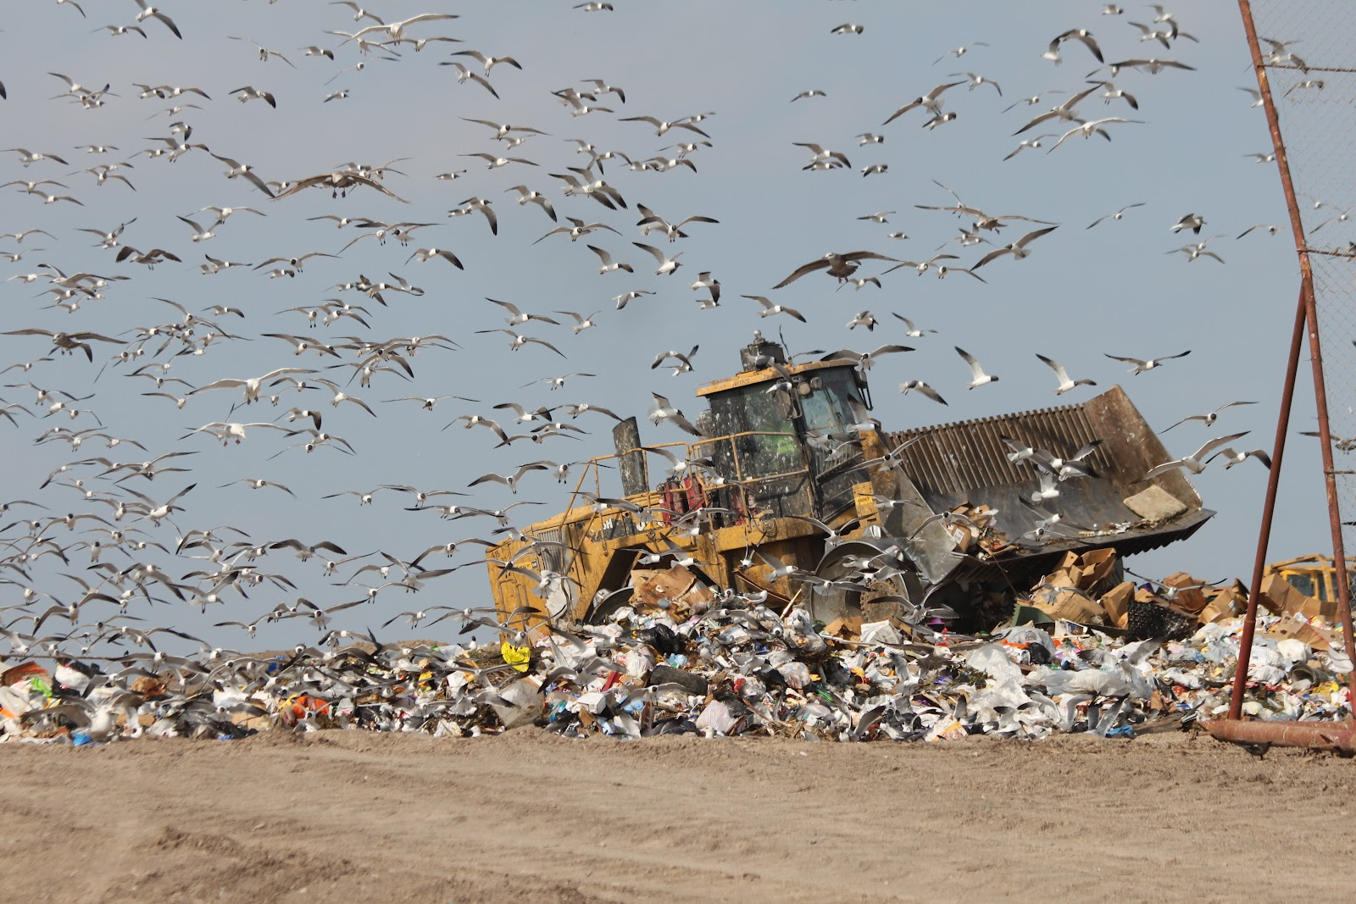
Green House Gases (GHG) 10,100,000 tons/year
GHG trap heat in the atmosphere & contribute to climate change
The largest sources in Cameron County, Silas Ray power plant and the municipal dump, only produce 130,815 tons

Slide 20
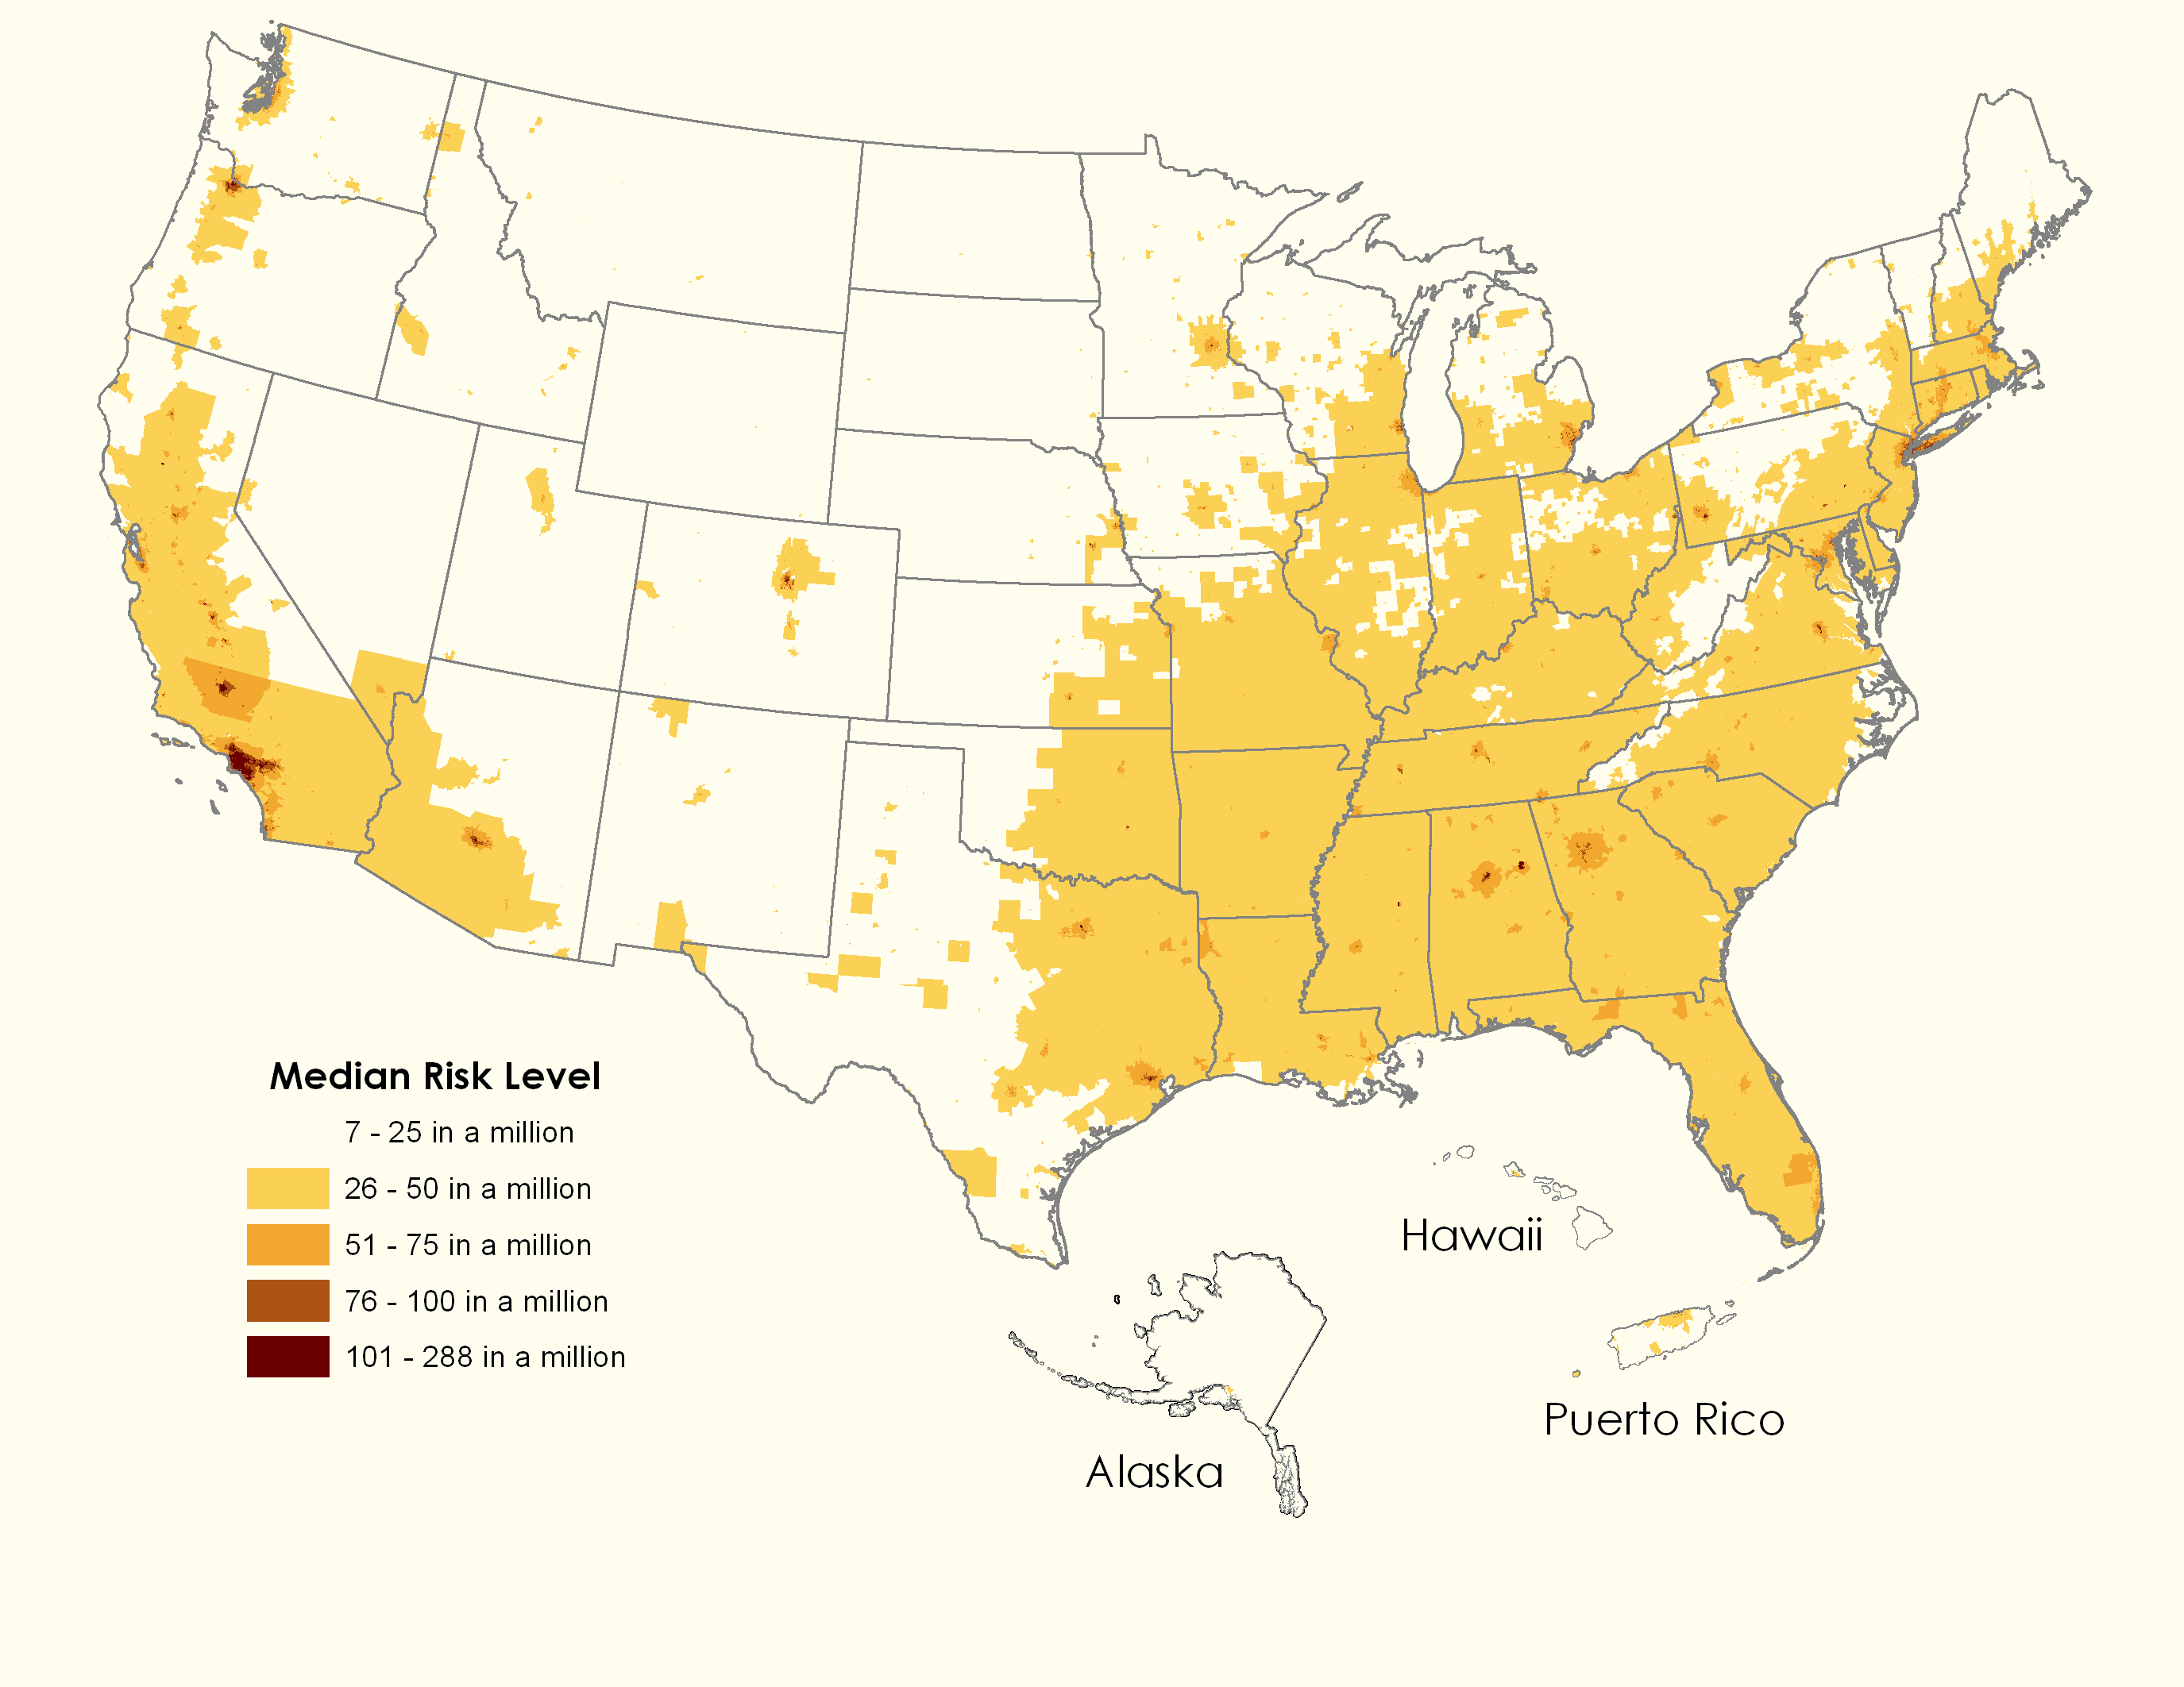
Volatile Organic Compounds (VOCs) 362 tons/year
VOCs contribute to smog, pollute water, and can cause cancer
A 5% increase to stationary sources in Cameron County!!!

Slide 21
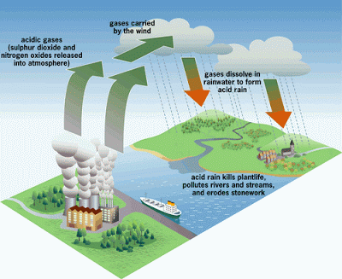
Sulfur Dioxide (SO₂) 25 tons/year
SO₂ forms acids that harm marine life and kill plants
A 9% increase to Cameron County!

Slide 22
Particulates 455 tons/year
Particulates small enough to be inhaled; children and the elderly are especially vulnerable

Slide 23
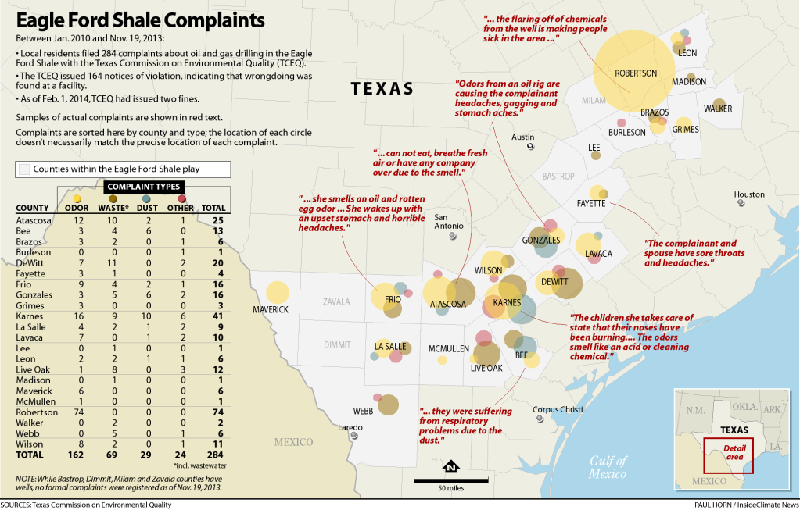
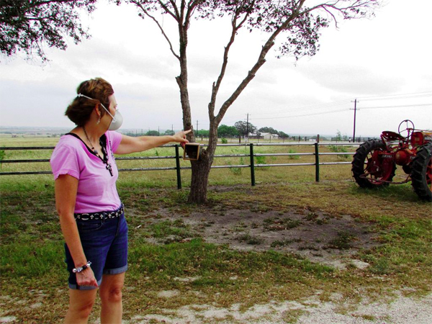
People are suffering, Texas Commission on Environmental Quality (TCEQ) is NOT reliable
Out of 164 violation notices, ONLY 2 fines have been issued.

Slide 24
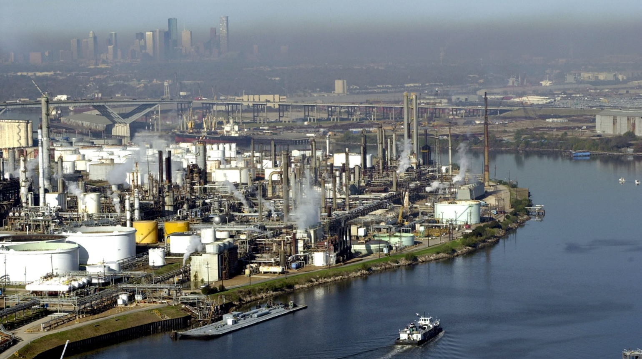
Other cities along the Texas coast are industrialized and they pay the price
Houston Ship Channel and Smog

Slide 25
Wildlife, Recreation, and Tourism
save RGV from LNG

Slide 26
RGV is known for wildlife, natural habitat, & eco-tourism- Harris’ Hawks, Green Jays, Kiskadees, and rare Aplomada Falcon: some species live ONLY here!
Photo courtesy Seth Patterson

Slide 27
LNG will disrupt important natural areas
S.P.I.
Wildlife Areas
Wildlife Crossing
LNG Lease Options
Highways
Notes:
South Padre Island is at upper right, the NE corner. Space X is at Highway 4 down in lower right quadrant; within ten miles of the these LNG facilities. Major BOMB if an accident.

Slide 28
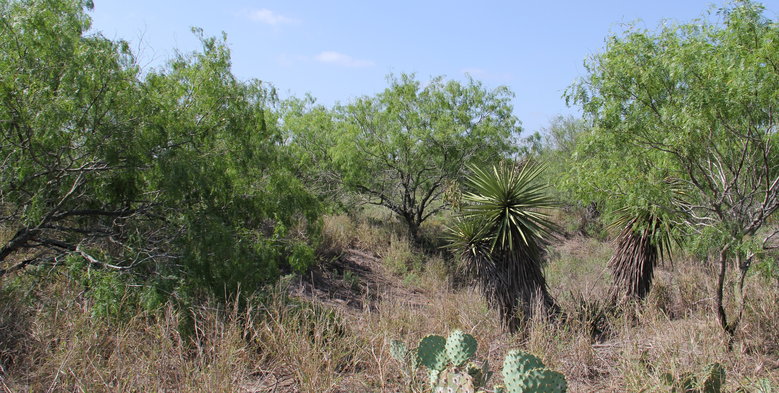
This is where Gulf Coast LNG wants to build

Slide 29
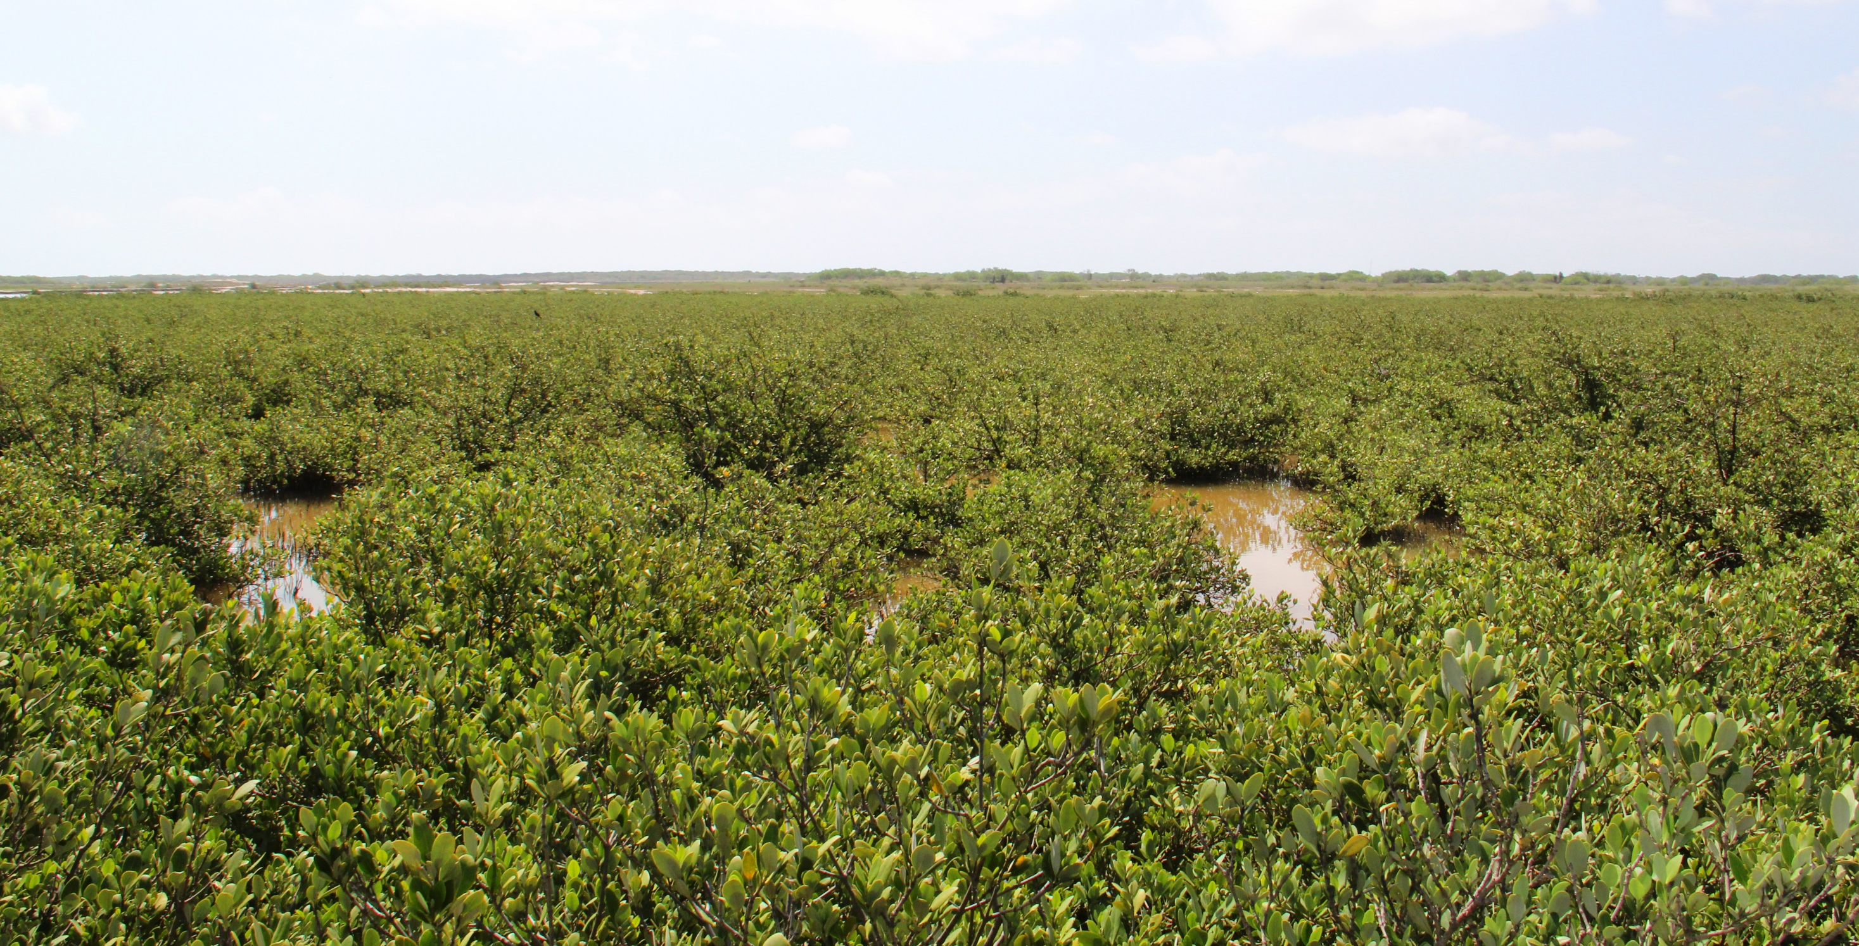
This is where Texas LNG wants to build: unique, rare Black Mangrove Swamps where wildlife must breed—Brown Pelican; Shrimp; many fish and other birds….

Slide 30
The Wildlife Corridor
Established in 1979 to protect the biodiversity of the LRGV
Home to 18 threatened and endangered species and critical to ocelot recovery
The corridor consists of 93 parcels of land between Laguna Atascosa and Falcon Dam. Animals need to travel between the parcels.
Photo courtesy Larry Ditto

Slide 31
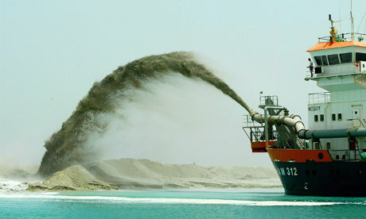
Why our wetlands are critical
Important nurseries for aquatic life
Water filtration systems
Prevent erosion of the coastline
What would LNG do to them?
Dredge and fill existing wetlands
with concrete, causing
IRREVERSIBLE damage

Slide 32
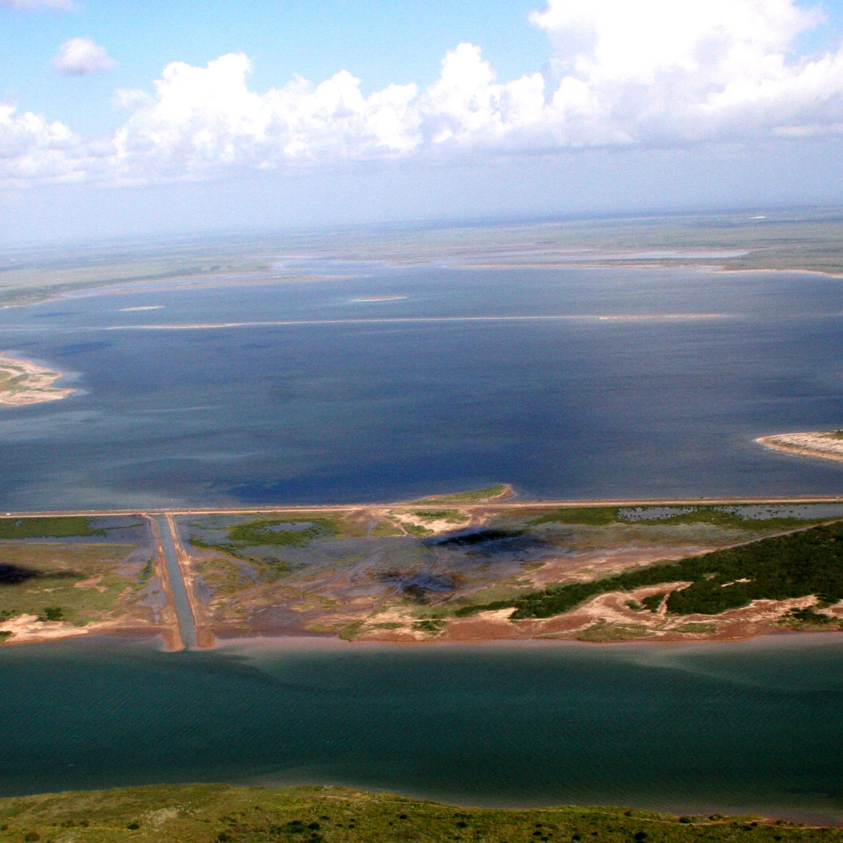
Bahia Grande
Water supply was cut off when the ship channel was dug in the 1930s
Water evaporated, fish and plants died, and it became a dust bowl blowing into peoples’lungs.
A new water supply channel was dug in 2005 and the bay restored.
This was the largest wetland restoration project in North America
LNG would damage this progress!
Photo credit The JASON Project at UTB

Slide 33
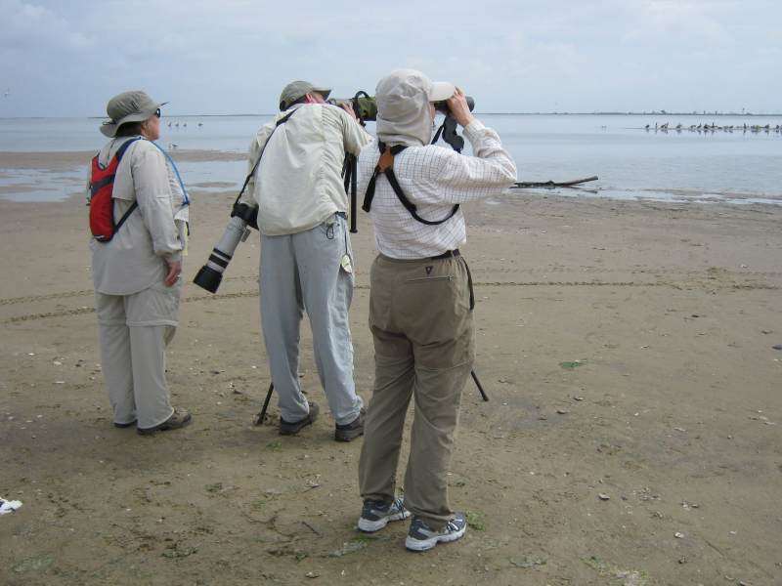
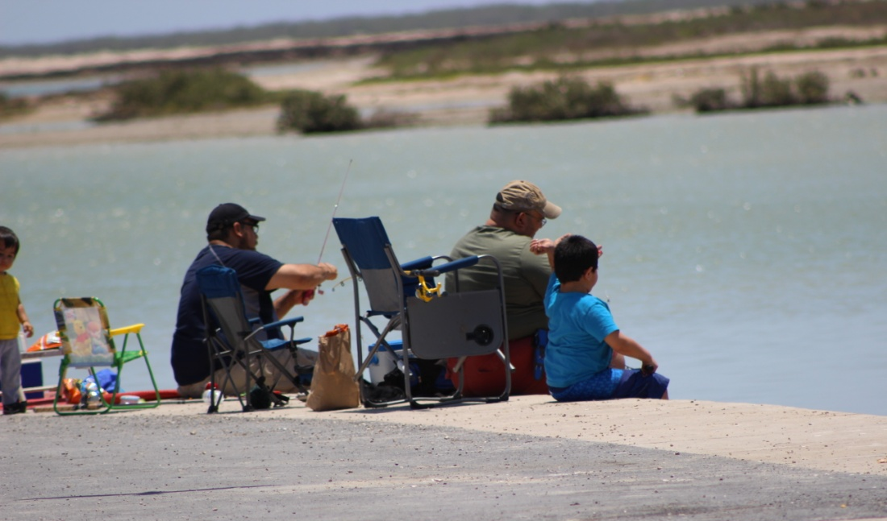
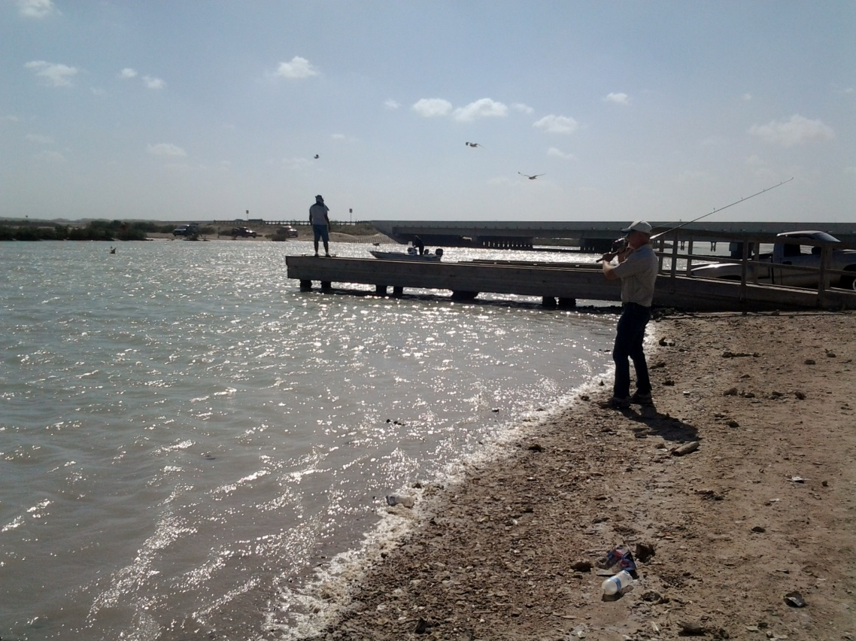
Recreation and tourism
Notes:
Change photos: birders, fishermen, kayakers, kite-boarding

Slide 34
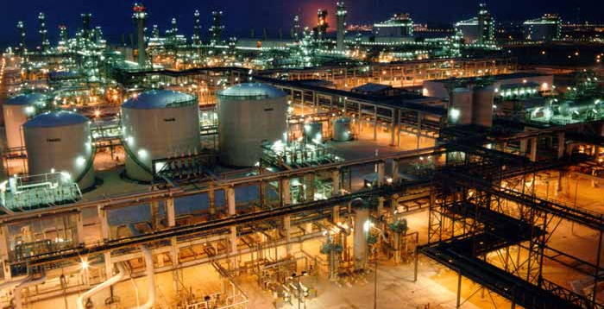
LNG is the opposite of conservation, recreation, and tourism

Slide 35
Economic Impact:harmful, globally, since economies depend on eco-systems
save RGV from LNG

Slide 36
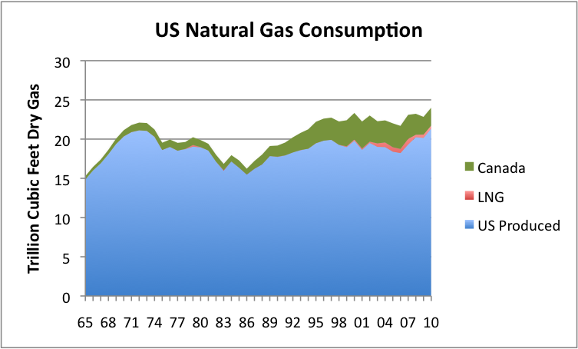
The U.S. uses more gas than it produces

Slide 37
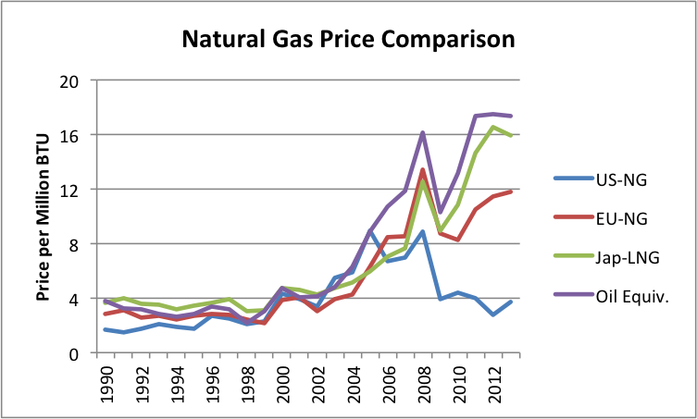
It is more profitable to sell gas overseas than here
Notes:
Re-write script

Slide 38
Exporting natural gas
will raise natural gas prices in the U.S.
EXCELLENT COUNTER-ARGUMENTS (against LNG) by Dow:
Exporting natural gas “will cause natural gas prices to increase dramatically, which will have repercussions throughout the U.S. economy.”
--Dow Chemical Press Release 2/11/14
Notes:
A lot of our electricity is from Natural gas powered plants**

Slide 39
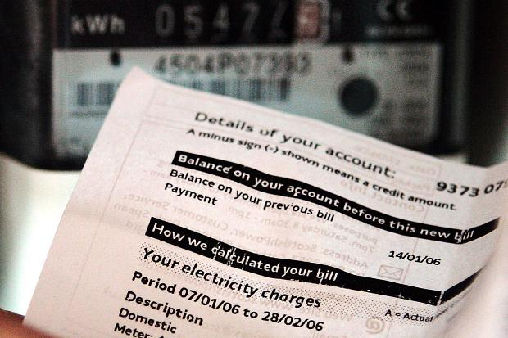
A lot of our electricity is made from natural gas
Higher prices at home
Higher prices everywhere
Notes:
A lot of our electricity is from Natural gas powered plants**

Slide 40
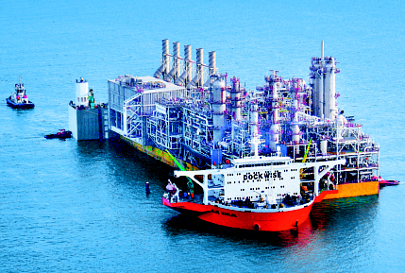
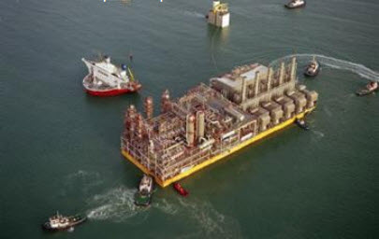
Will there be jobs? Few permanent jobs. But Cameron County has passed tax abatements to pay their benefits.
Many LNG facilities are built on barges, not locally constructed. Shell Oil has the Prelude, largest tanker ever, doing LNG on it.

Slide 41
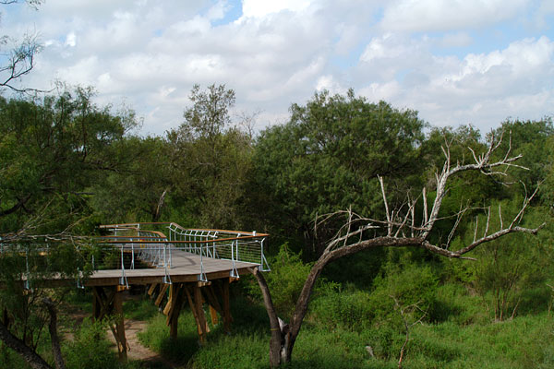
Nature Tourism = $463 million/year
Notes:
A lot of our electricity is from Natural gas powered plants**

Slide 42
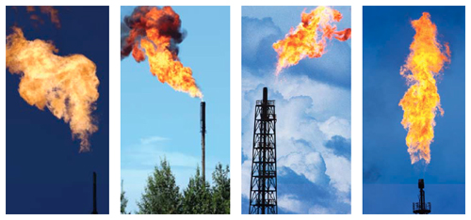
7,500 birds killed in LNG gas flare in one night
Canaport LNG, New Brunswick
Notes:
A lot of our electricity is from Natural gas powered plants** THEY SAY they aren’t going to use flares. But we saw them at the Louisiana plants which are similar.

Slide 43
Beach Tourism = $300 million/year
Notes:
A lot of our electricity is from Natural gas powered plants**

Slide 44
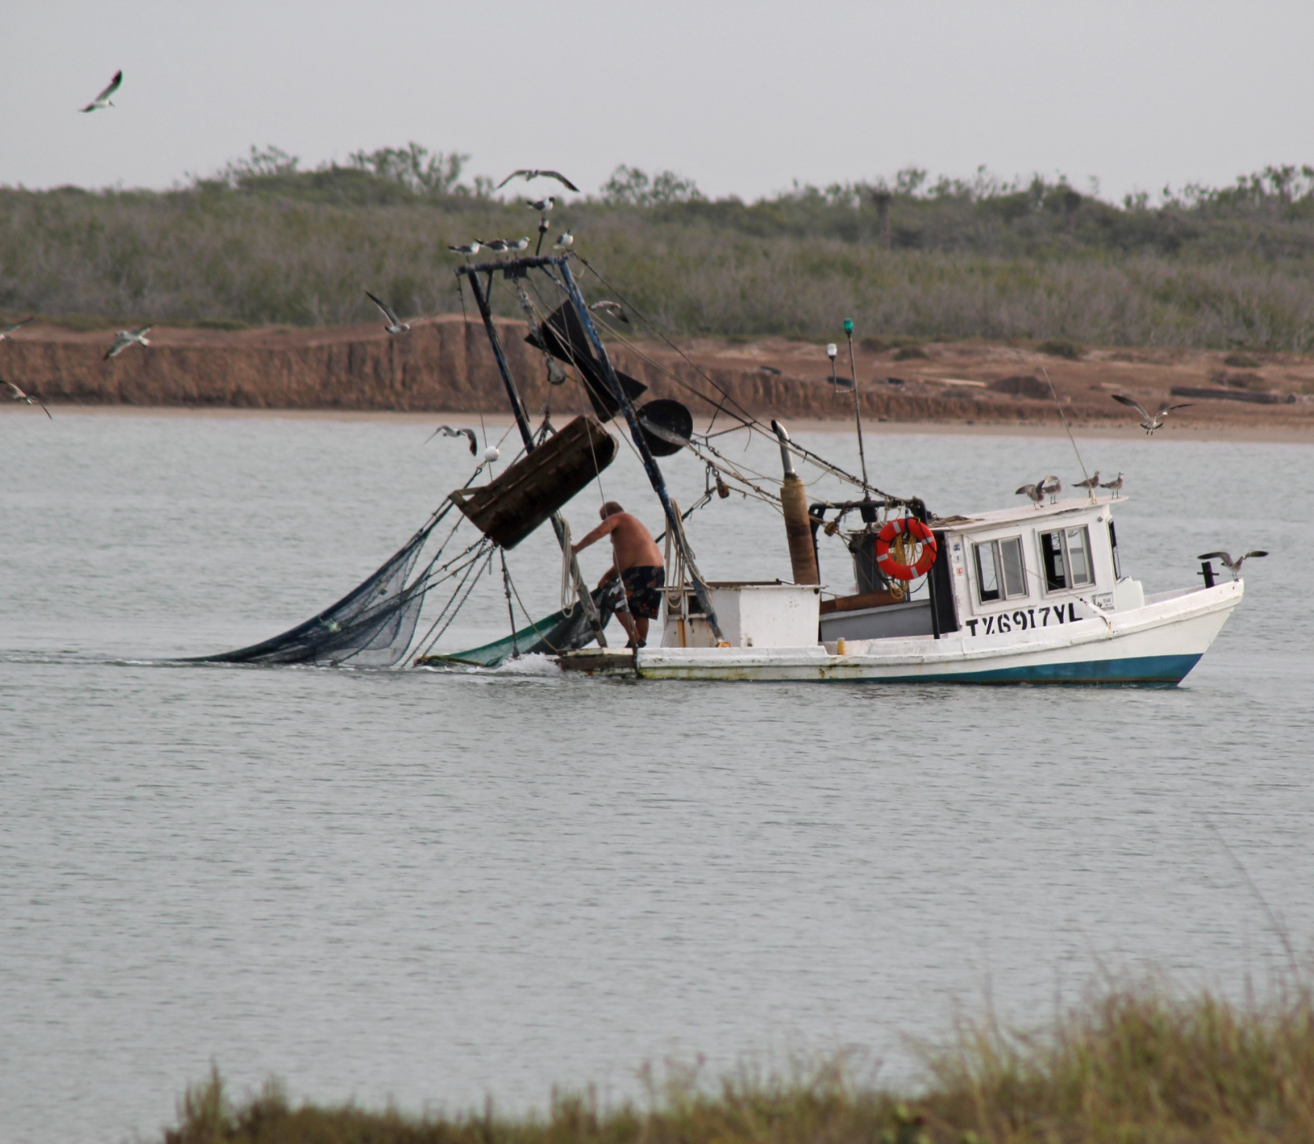
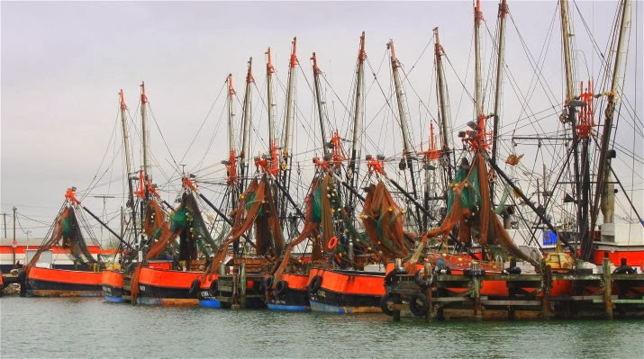
Fishing & Shrimp Industry
38% of all Texas shrimping permits are in the Brownsville/Port Isabel/So. P. Island
7th largest commercial fishing port
according to NOAA National marine
Fisheries Service
30.5 million lbs. of shrimp, valued at $52 million/yr.

Slide 45
The big picture: LNG and Fracking that “feeds” it gas greatly worsen Global Warming! Total LNG energy production costs exceed those of producing coal & oil. They hurt eco-systems and Earth’s atmosphere even more than oil & coal. Therefore, it cannot be argued validly that LNG is a “transition” fuel preferable to oil/gas. It’s not!
save RGV from LNG

Slide 46
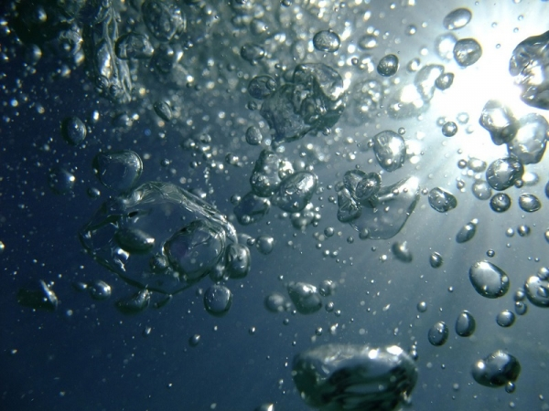
Story Source: CAGE – Center for Arctic Gas Hydrate, Climate and Environment. Author: Maja Sojtaric.
IMAGE to the RIGHT is of Bubbles of METHANE (LNG is made of this gas, but if frozen, it does not trap heat from above) being released from Arctic waters over permafrost, which is under water there, and heating up, increasingly.
Journal References:
Alexey Portnov, Jurgen Mienert, Pavel Serov. Modeling the
evolution of climate-sensitive Arctic subsea permafrost in
regions of extensive gas expulsion at the West Yamal shelf. Journal of Geophysical Research: Biogeosciences, 2014; 119 (11): 2082 DOI: 10.1002/2014JG002685
Alexey Portnov, Andrew J. Smith, Jürgen Mienert, Georgy Cherkashov, Pavel Rekant, Peter Semenov, Pavel Serov, Boris Vanshtein. Offshore permafrost decay and massive seabed methane escape in water depths >20 m at the South Kara Sea shelf. Geophysical Research Letters, 2013; 40 (15): 3962 DOI: 10.1002/grl.50735
Notes:
Methane Hydrate is being released from methane in solid form at ocean bottom, at a rate of 500 TIMES GREATER than “normal.” One wonders why, given this global catastrophe, armies of the world are not being deployed there, with funds going to worsening the problem with LNG and fracking! What could we do, besides lowering androgenic GHG releases like Methane, Nitrous Oxides, etc.? Why not have the SeaBees (Construction Battalions, US Army) lay Marsten Mat on the ocean floor to prevent the worst of this until we can be the global temperatures to stop rising and inevitably causing more of these disastrous, and ever more dangerous, irreversible releases? What is “Carbon Recapture,” which Clinton Foundation is working on? How could it help, if at all, in THESE situations? IF LNG, fracking, and coal use along keep going, we are all “dead ducks” by 2025, if you do the math!

Slide 47
"If the temperature of the oceans increases by two degrees as suggested by some reports, it will accelerate the thawing to the extreme. A warming climate could lead to an explosive gas release from the shallow areas."
Permafrost keeps the free methane gas in the sediments. But it also stabilizes gas hydrates, ice-like structures that usually need high pressure and low temperature to form.
"Gas hydrates normally form in water depths over 300 meters, because they depend on high pressure. But under permafrost the gas hydrate may stay stable even where the pressure is not that high, because of the constantly low temperatures."
Gas hydrates contain huge amount of methane gas, and it is destabilization of these that is believed to have caused the craters on the Yamal Peninsula. Author: Maja Sojtaric. Note: Materials may be edited for content and length.
“A GOOD PLANET is HARD to FIND!” (All life is at risk now.)
Why court the earlier death of our planet’s systems of life when we can avoid and prevent these technologies if we try!?
HEALTH EFFECTS of FRACKING and LNG: Asthma, Cancers, Respiratory Diseases, Burns; Deafness, Disasters. http://www.medact.org/wp-content/uploads/2015/03/medact_fracking-report_WEB3.pdf Shale gas development, which both fracking and LNG involve, frequently produce (450 scientific studies since 2008): “Elevated concentrations of air pollutants and ...incidents of water pollution contamination. “Fracking is also a disruptive and intrusive activity that will spoil the natural environment; create noise and light pollution; and impose a variety of social and economic stressors onto surrounding communities.” LNG does the same, and even so over the oceans as the condensed gas ships through hot weather to the other side of the Earth, to be sold to China or the Ukraine, where prices are temporarily higher. For how long?! And when the price does not justify this HUGE expense in obtaining an old fossil fuel, ... What THEN?!

Slide 48
As of 04.2015, Annova and TX LNG were seeking FERC* permits. 11.2017, 3 left.
SpaceX has developed their land at Boca Chica Beach near Brownsville, within ten miles of the planned LNG facilities. SpaceX wisely requires a three mile buffer zone, but a rocket blown off course could, of course, ignite the “POOL” of invisible GAS released in the LNG production process, ... Causing the whole coast of TX to be blown up, and toxic fires of “burning air,” for many miles around, up and down the Valley and Border areas, --not something tourists or locals would survive easily. But then is too late!
The Federal Energy Regulatory Commission (“FERC”) is the only agency that must approve this LNG project, strangely. The EPA and other public health agencies appear to have little power here.
Prior LNG projects in Louisiana gained easy approval, in spite of some catastrophic accidents in this field worldwide.
We need to brainstorm ways to insure the public safety, ... And plan alternative energy projects!

Slide 49
So, how does the GAS get to the LNG Facility, whether floating or in Port of B’ville?
Even though the supply of natural gas expected to come from the shale deposits in TX and MX are not “forever,” and indeed some say only for a few years at most, the pollution they cause lasts forever!
PIPELINES will be needed, and these pipelines running from fracking wells to the LNG Facility will require temporary labor, provide only a few jobs, but the pipelines will stay in the ground “forever,” though they will leak, burn corrode, etc., and destroy habitat in the construction process. But the habitat they traverse is full of rare and endangered species of plants and animals, who will go extinct.

Slide 50
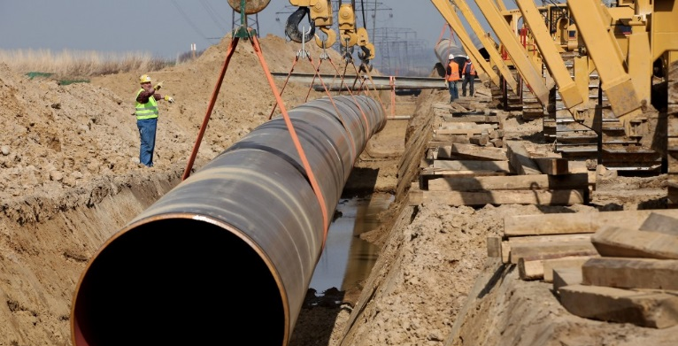
LNG will require new pipelines- Valley Crossing underway: Rio Bravo coming along.
Notes:
Salt and sea water will corrode these pipes.....and leaks will poison land and sea.... The Rio Grande Pipeline is coming soon, and the Valley Crossing Pipeline is destroying my friend’s cow/calf operation here near Harlingen. The BLAST ZONE is a half mile wide, ¼ mile from each side, but HUGE. 48 inch pipes can be disrupted by earthquakes, tremors during more intense hurricanes, etc.

Slide 51
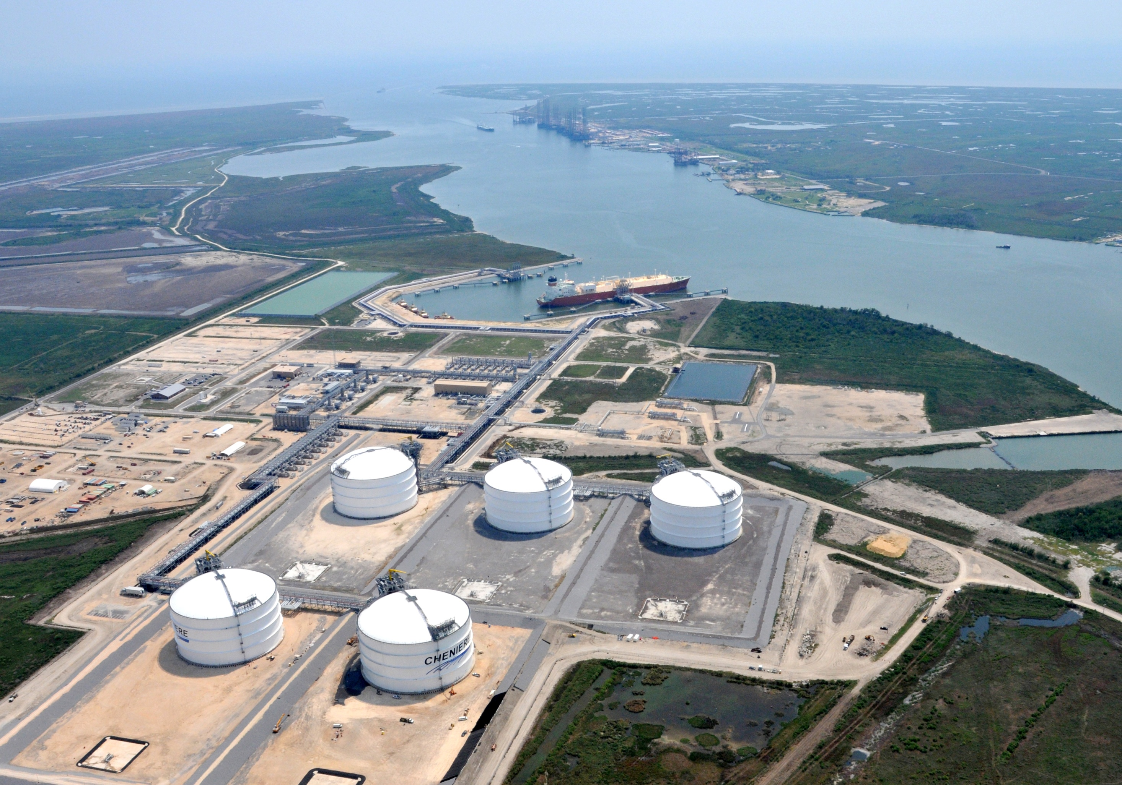
What will we be left with after LNG? Radioactive radium from the Fracked Gas from which it is produced? Surely: Hydrogen Sulfide? (H2S caused one prior Mass Extinction, killing 99% of marine life, turning skies a sickly green,- seas a putrid purple.) (Kolbert, E. The Sixth Extinction)

Slide 52
Scientific Consensus, as with Climate Change, shows fracking hurts air, water Quality and endangers the public health
More heat releases Arctic Methane! But METHANE will also be leaking from LNG in transit!
http://www.psehealthyenergy.org/data/Database_Analysis_2015.1_.27_1.pdf
Excellent Bibliography here! Shows most see great danger.
Also cites the mere two articles by scientists who try to argue that the health effects aren’t “significant,”...
...( or ? Relate to chain smoking only???)
GLOBALLY, our leaders MUST see:
Business As Usual (BAU) is suicidal.
The damage is IRREVERSIBLE!
Less than 8% of all peer-reviewed scientific publications on hydraulic fracturing claim there are no significant health risks from fracking. The vast majority of those who study recent effects urge great caution and give reason for serious worries about the safety of fracking not to mention the ecological benefits of developing alternative sources of energy!
METHANE heating up oceans and air from above and below: we’re all COOKED! We need to act yesterday! No more BAU !!! =

Slide 53
http://www.techtimes.com/articles/23213/20141227/methane-leaking-from-siberian-permafrost-dangerous-addition-to-greenhouse-gas-emissions.htm HUMAN-made METHANE TRAPS HEAT 27-33 TIMES WORSE than CO2! It warms the planet VERY fast, being lighter than air, and resting above the other layers of air, blankets in the heat. This is releasing a HUGE quantity of natural, pre-existing Methane, far worse PER MOLECULE than CO2, which receives more attention, unfortunately, given the need to FOCUS, LEAD, and MOTIVATE the PUBLIC to ask leaders to help to ACT in time! NOISE will also be a HUGE PROBLEM: ALREADY, UNITS BUILT NEARBY PUMP NOISILY. LNG IS ENERGY INTENSIVE.
Alarming Quantities of Methane ... Escaping from the Pacific Seafloor, Warn Scientists. Methane, Hydrogen Sulfide, Nitrous Oxide, and Carbon Monoxide, also, result from the LNG production process. Hugely toxic.

Slide 54
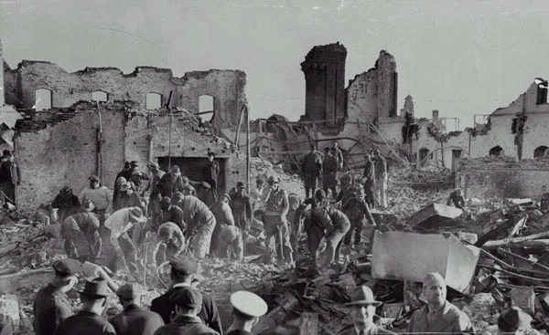
“Hey, guys,... I’m from Cleveland, city of “the River that Burned” (1960s)... And so:
I am especially motivated to resist and prevent such disastrous production constructions as the planned
LNG facilities in the RGV. [See this site http://www.timrileylaw.com/LNG.htm]
The ORIGINAL disaster in the first-ever LNG
plant was in my home city, Cleveland, OHIO.
My family lived through this, but taking hope
and courage from such terrible
errors, we lived and helped, as
well, in the clean-up of Lake
Erie and the Cuyahoga River, etc....
NEVER AGAIN! LNG destroyed a
whole square mile of houses,
streets, and Infrastructure in
Cleveland! Holding tanks had failed
And gas ignited in the sewers,
easily. If released gas in the LNG
Production process can blow up in the sewers of Cleveland, how much more likely it is to ignite in the hot skies over deep South Texas in our extreme heat, with rocket fuel igniting nearby.

Slide 55
Want to do something?
Connect!
Facebook: save RGV from LNG
saveRGVfromLNG.info
email: nolng4rgv@gmail.com
call: 956.410.0794
Join us!
Tell a friend
Contact politicians and leaders
Ask Questions!
Sierra Club – sierraclub.org

